Slide 1
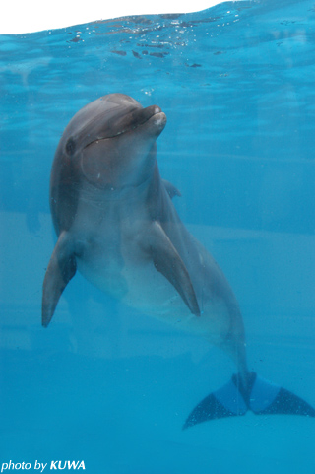
sea animals
dolphin

Slide 2
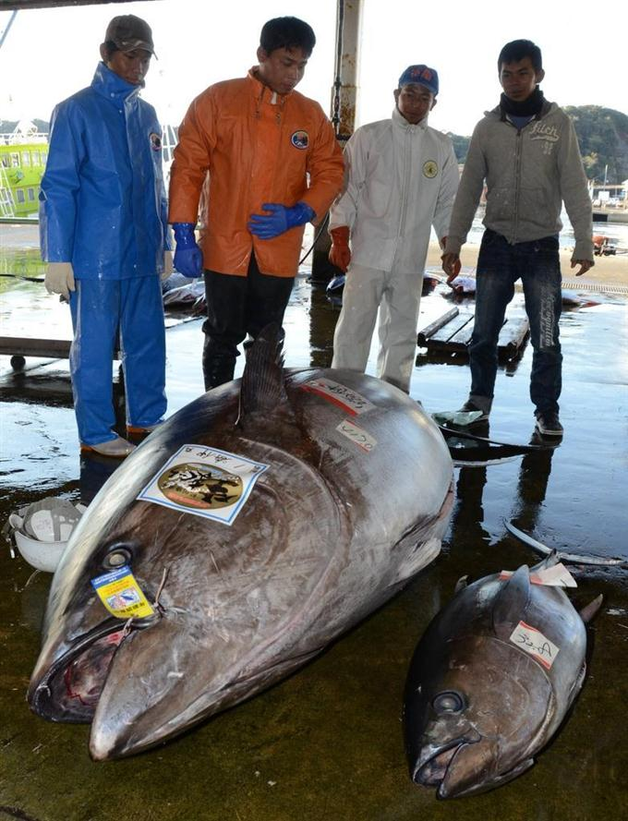
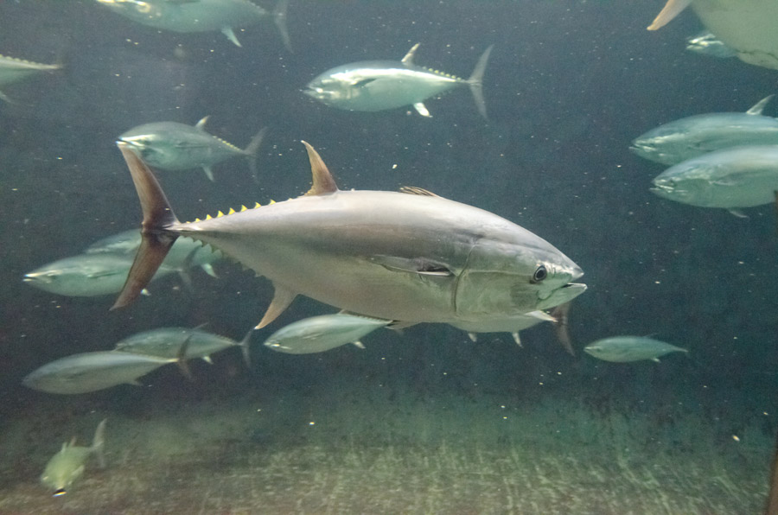
tuna

Slide 3
Which is bigger?
vs
＜
2-3m
3-4m

Slide 4
The dolphin is big.
The dolphin is bigger than the tuna.

Slide 5
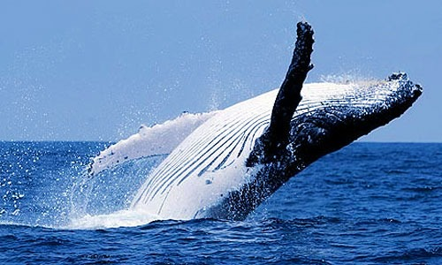
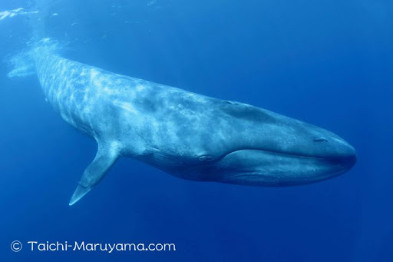
Blue whale

Slide 6
Which is the biggest?
vs
vs
2-3m
25m
3-4m

Slide 7
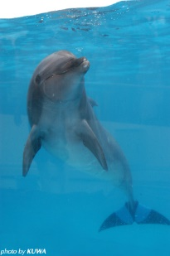
The blue whale is the biggest
of the three.

Slide 8
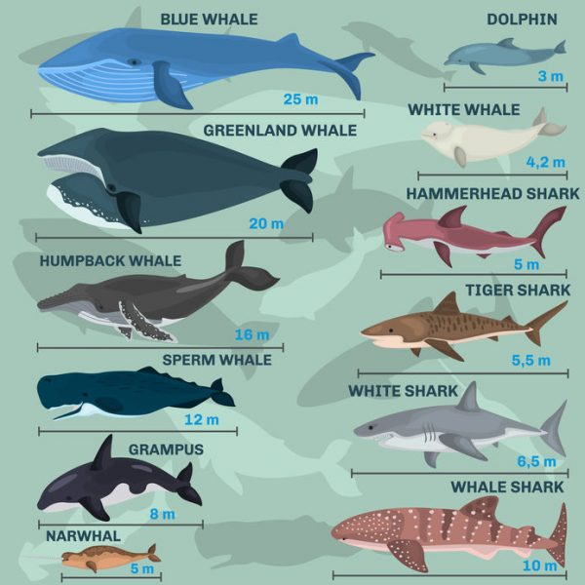

Slide 9
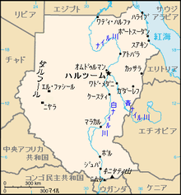
The longest river in the world
The Nile
(6650km)

Slide 10
Which is bigger?
vs
＜
2-3m
3-4m

Slide 11
Which is taller?

Slide 12
Which is older?

Slide 14
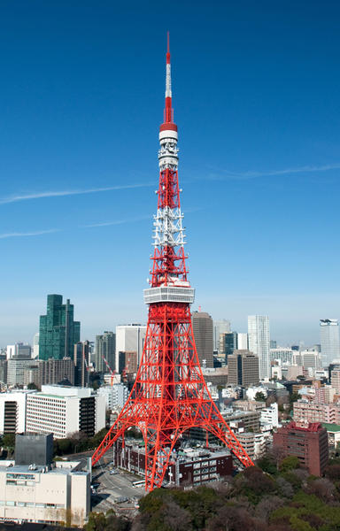
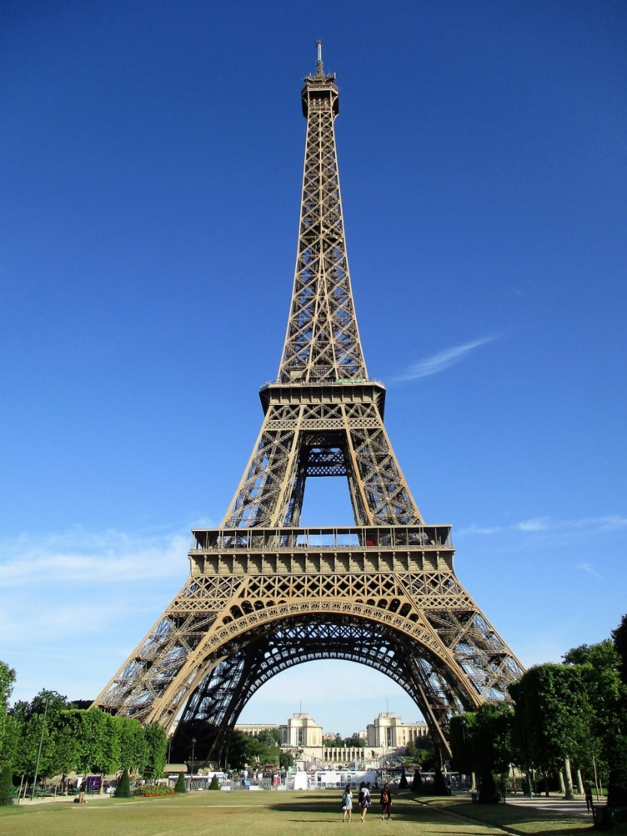
Which is taller?
300m
333m

Slide 15
vs
＜
2-3m
3-4m

Slide 17
300m
333m

Slide 18
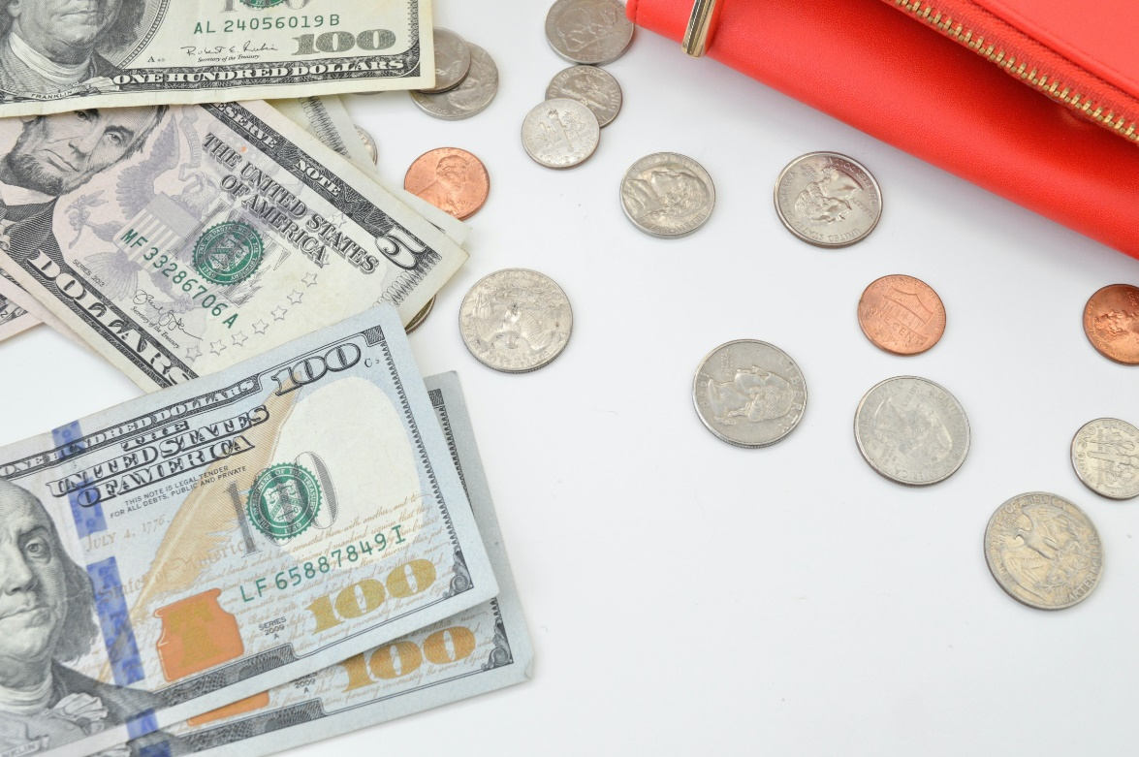
Which is more important?
money
time

Slide 19
is more important than
Money
time.

Slide 20
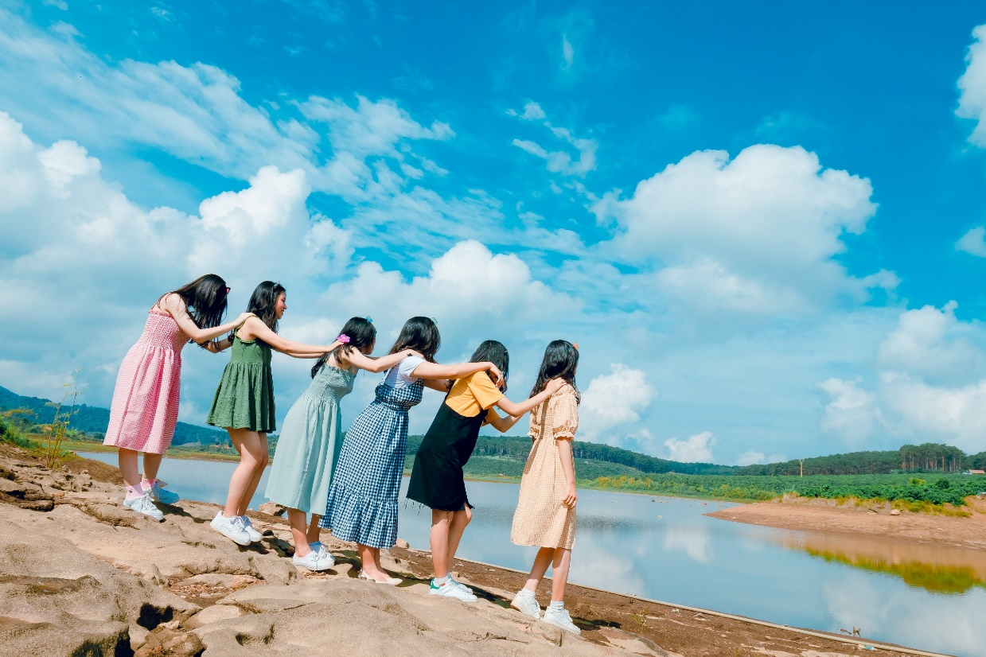
Which is more important?
love
friendship

Slide 21
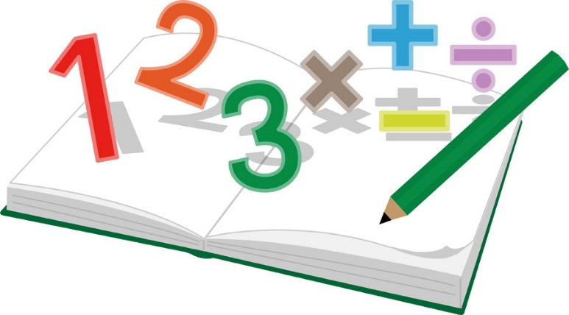
Which is more difficult?
English is more difficult than math.

Slide 22
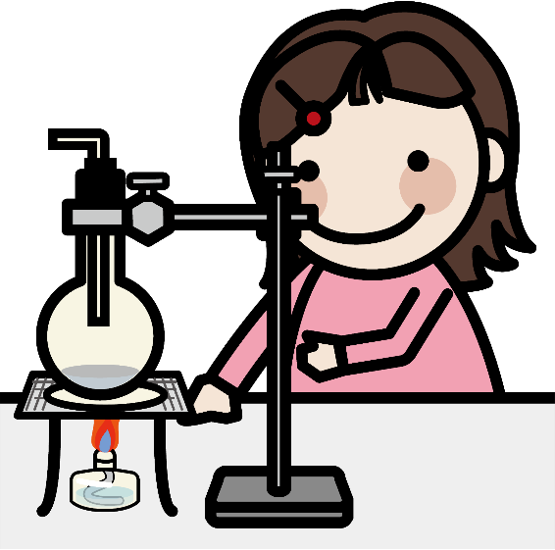
Which is more difficult?
( ) is more difficult than ( ).

Slide 23
Which is the most difficult?
( ) is the most difficult of the four.

Slide 25
What is your best memory in 2020 ?
学校行事の絵と英語名
【 】 is my best memory.

Slide 26
What is the best ramen restaurant in （場所）?
人気ラーメン店の写真
【 】 is the best ramen restaurant in （場所）.

Slide 27
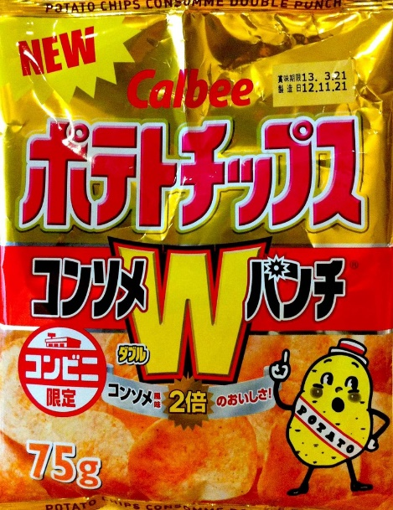
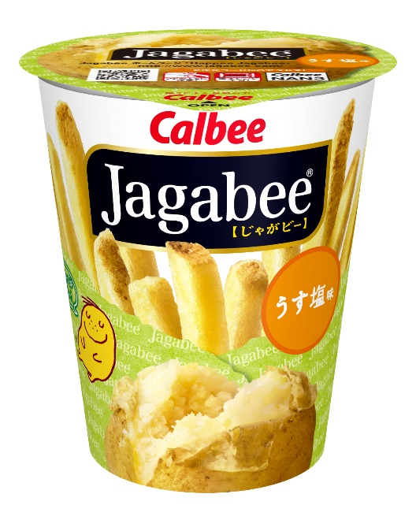
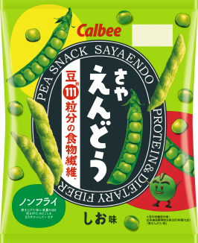
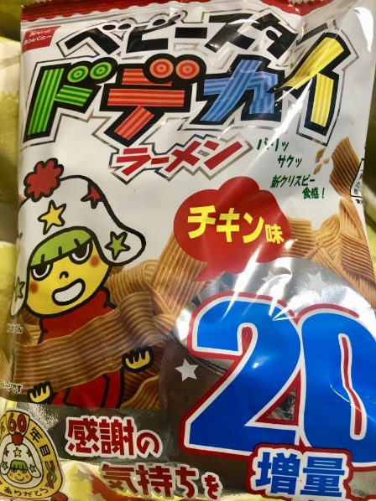
What is the best snack for you?
【 】 is the best snack (for me).

Slide 28
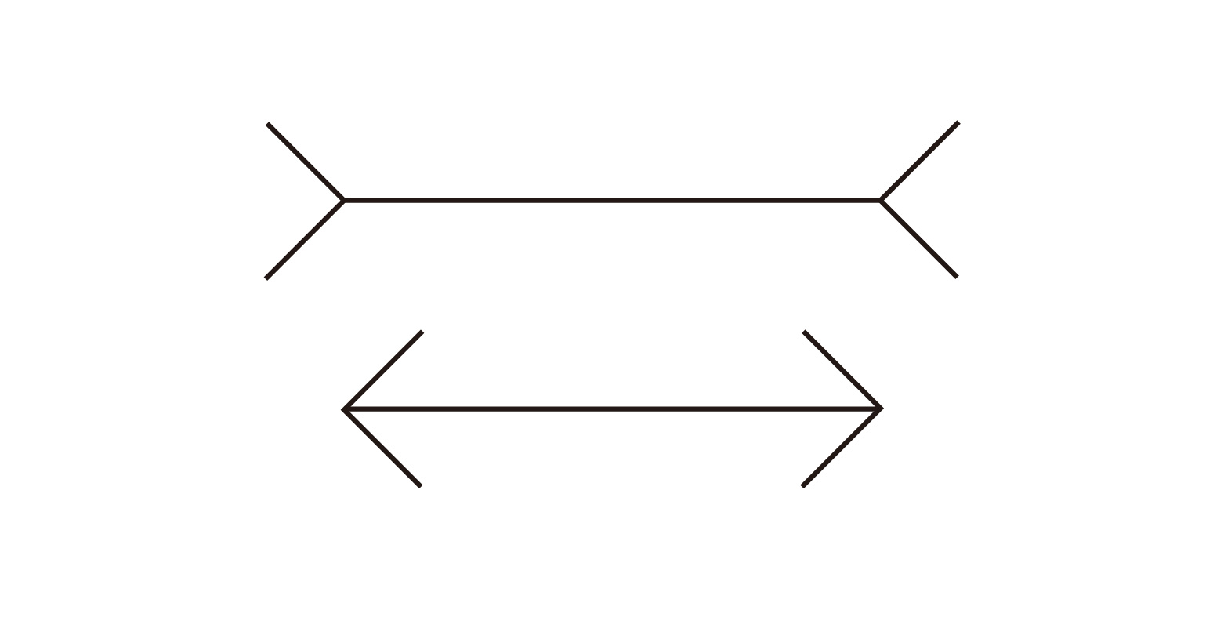
Which is longer, A or B ?
A
B
A = B

Slide 29
A is as long as B.
A
B
A = B

Slide 30
A is as big as B.
Which is bigger, A or B ?
A B

Slide 31
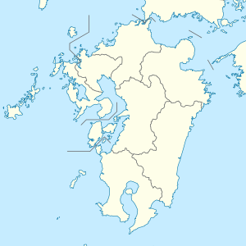
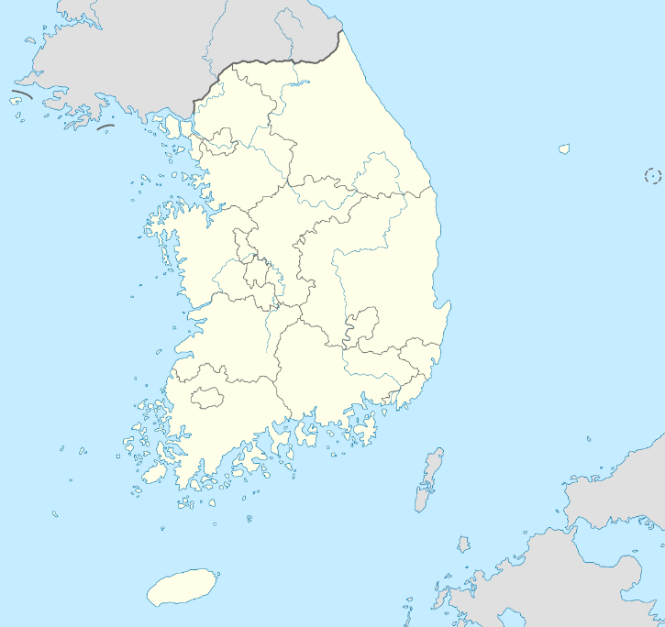
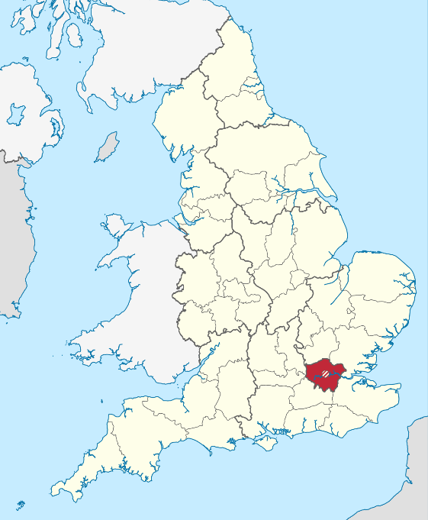
Hokkaido is as large as ( ) .
A B C

Slide 32
Hokkaido is as large as Korea .

