Slide 1
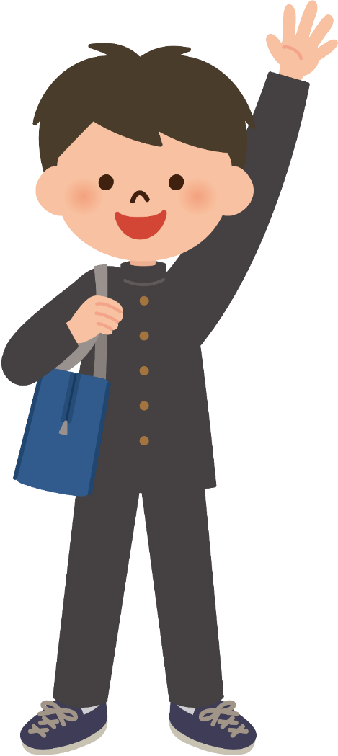
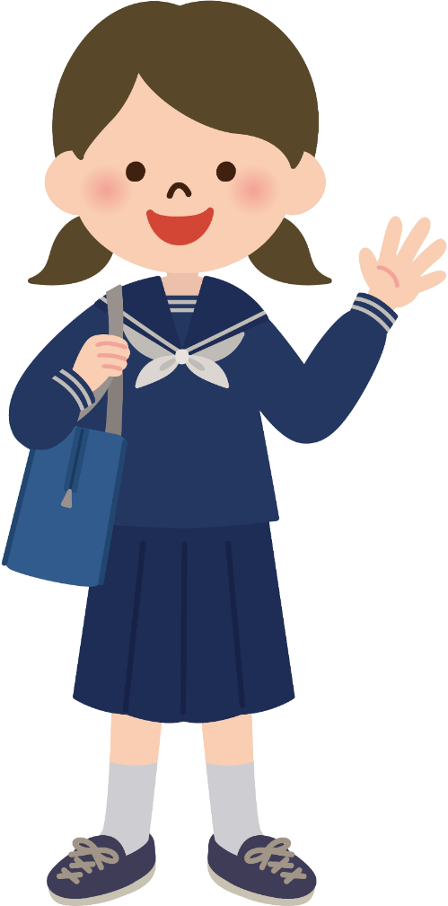
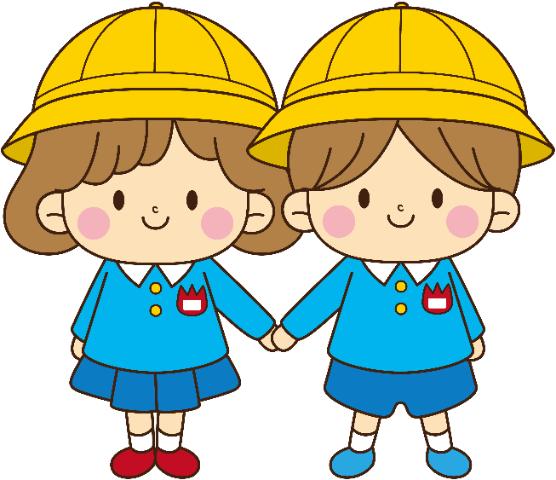
young /
a teenager
little /
a kid

Slide 2

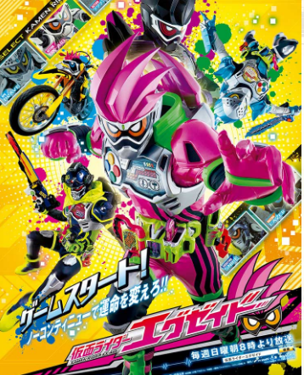
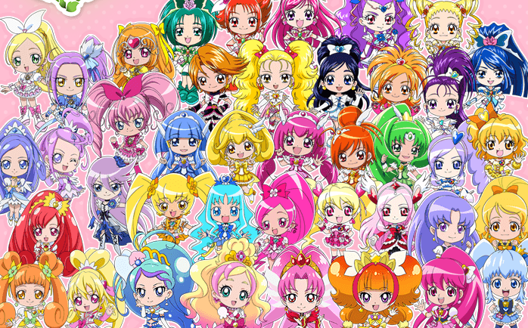
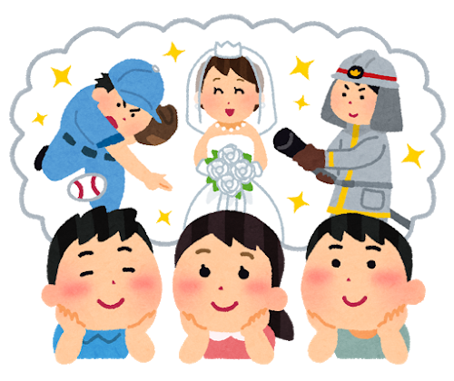
When I was little,
I wanted to be
a Kamen Rider!
I wanted to be
Puri-Cure!
I wanted to be
a ________ !

Slide 3
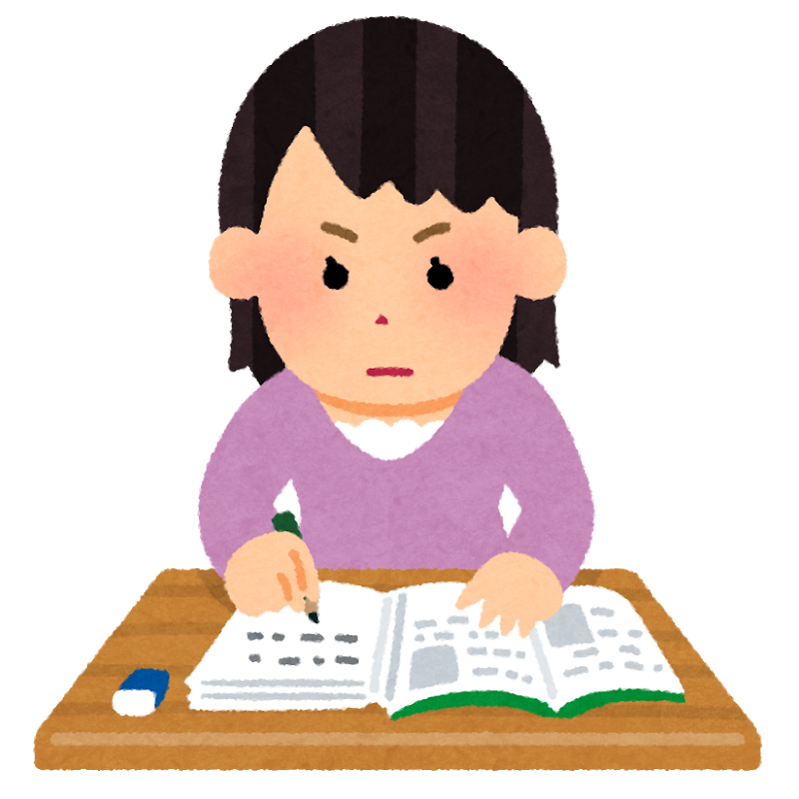
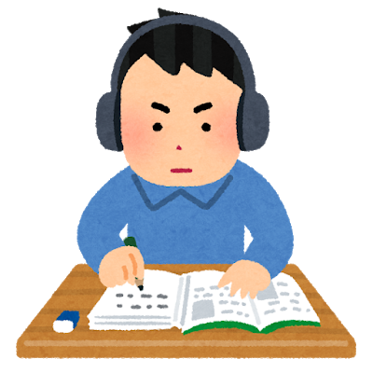
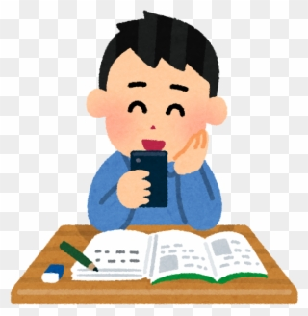
When I study at home,
I listen to music.
I focus on studying.
I use my
smartphone.
♪
キリッ
♪
♪

Slide 4
Vocabulary
I always liked...いつも～が好きだった
My dream has changed わたしの夢は変わった
I still like ... 今でも～が好きだ

Slide 5
1 質問があるときは，聞いてくださいね。
( )( )( )questions, please ask me.
2 小さい頃は，歌手になりたかった。
( )( )( )little, I wanted to be a singer.
3 私が話しているときは，私の方を向くこと。
You have to look at me ( )( )( ) talking.
( When )( you )( have )questions, please ask me.
( When )( I )( was )little, I wanted to be a singer.
You have to look at me ( When )( I )( am ) talking.

Slide 6
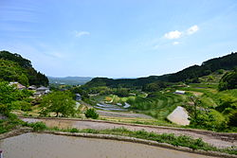
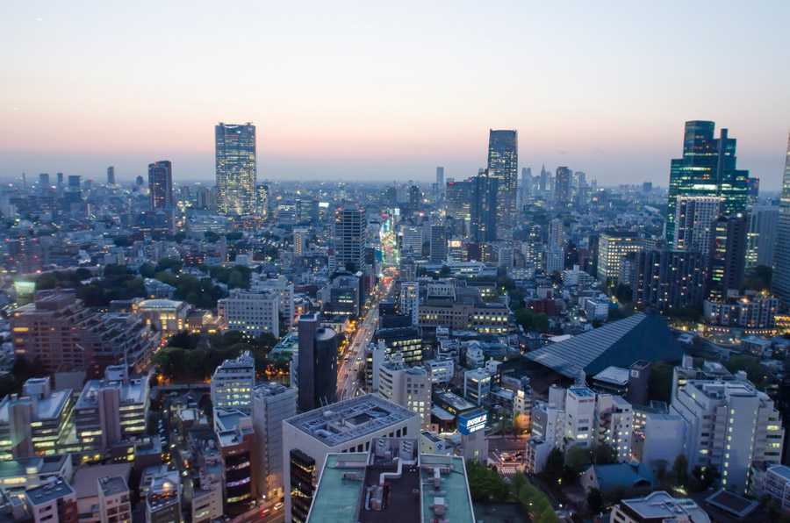
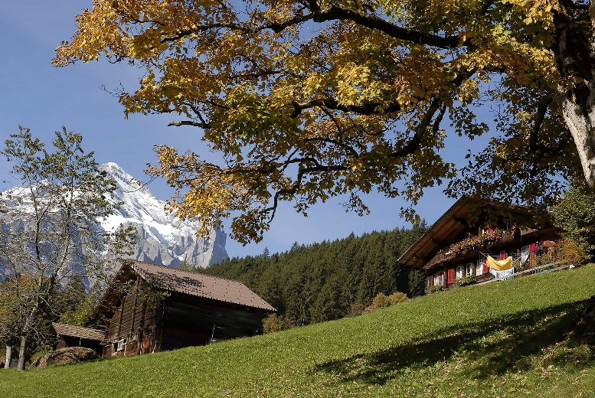
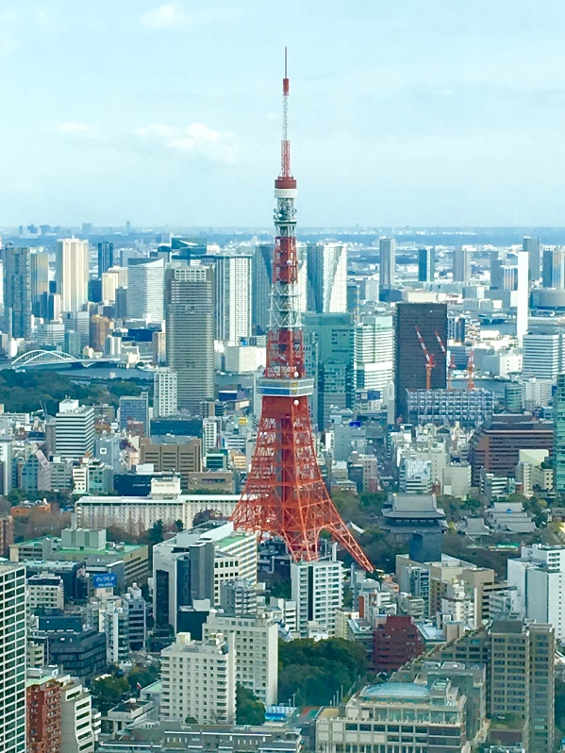
Which do you want to live in,
a big city?
a small town?

Slide 7
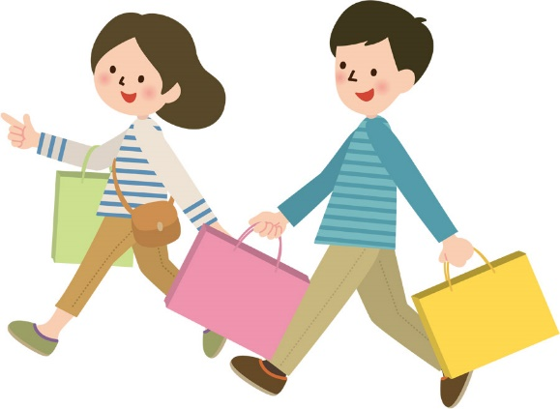

I want to live in a big city
because I can enjoy shopping.

Slide 8
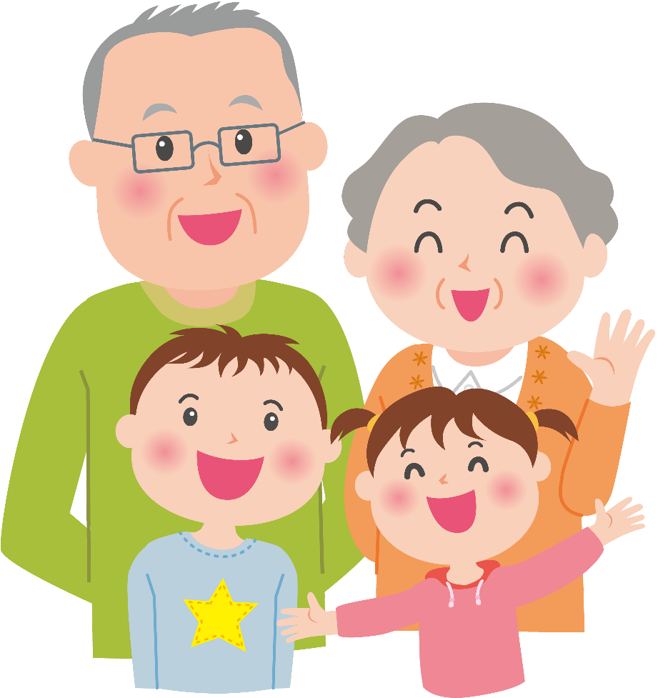
I want to live in a small town
because people are kind.

