Slide 2
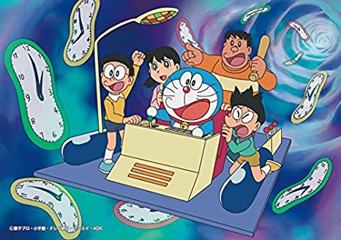
If I had a time machine,
I would go to the
past.
I would go to the future.

Slide 3
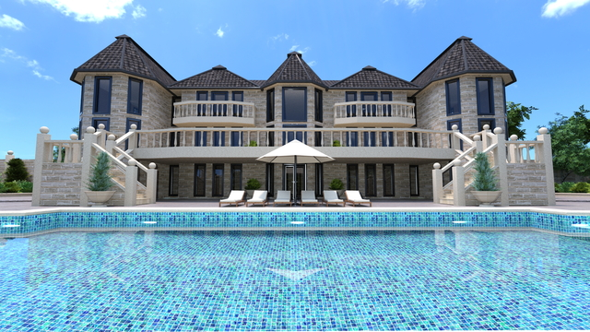
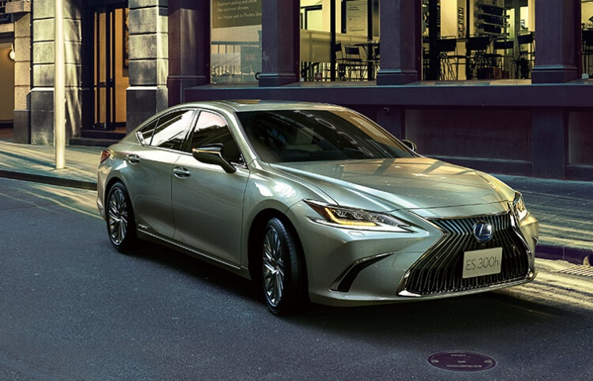
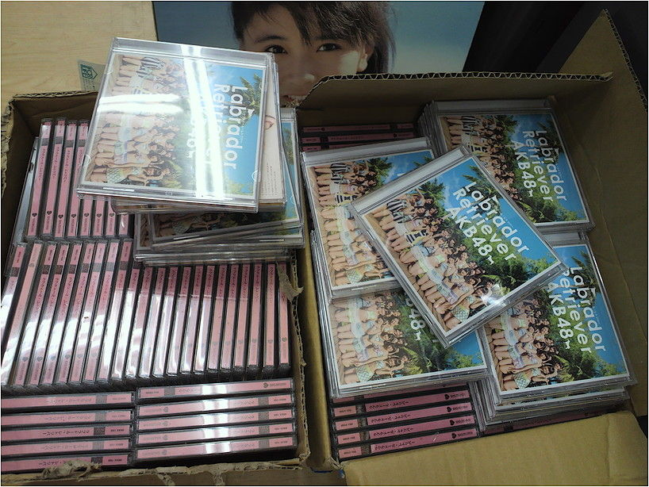
If I had 1,000,000 yen,
I would buy
a big house.
I would buy
many CDs.
(games / books)
I would buy
a cool car.

Slide 4
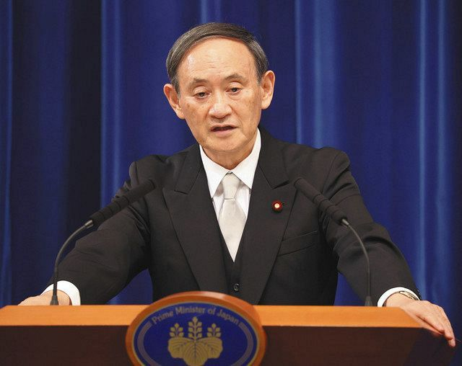
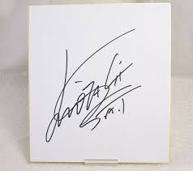
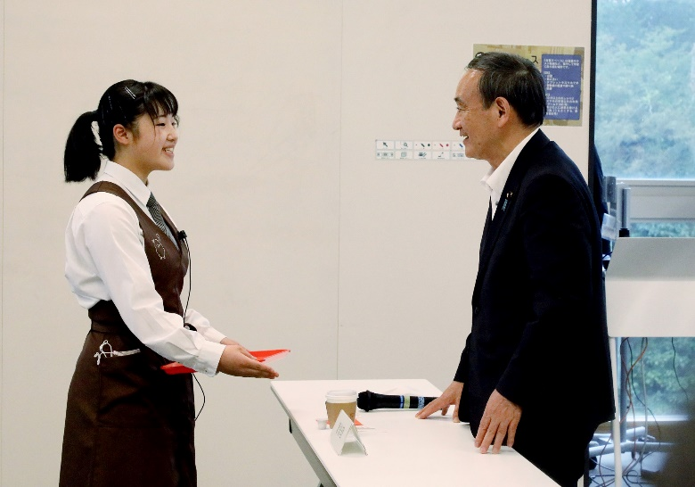
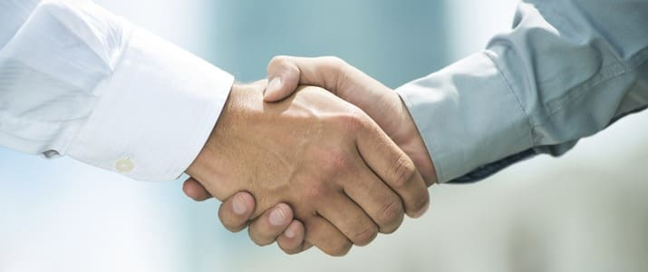
If I saw Mr. Suga,
I would get
his autograph.
I would talk to him.
I would shake hands with him.

Slide 5
If I had a time machine,
I would go to the
past.
I would go to the future.
Why?
What do you want to do?

Slide 6
Thinking time
Why?
What do you want to do?

Slide 7
Studying
What subject do you like?
How long do you study at home?
Do you do your homework
before dinner?
after dinner?
before taking a bath?
Do you listen to music while studying
(勉強中に）

Slide 8
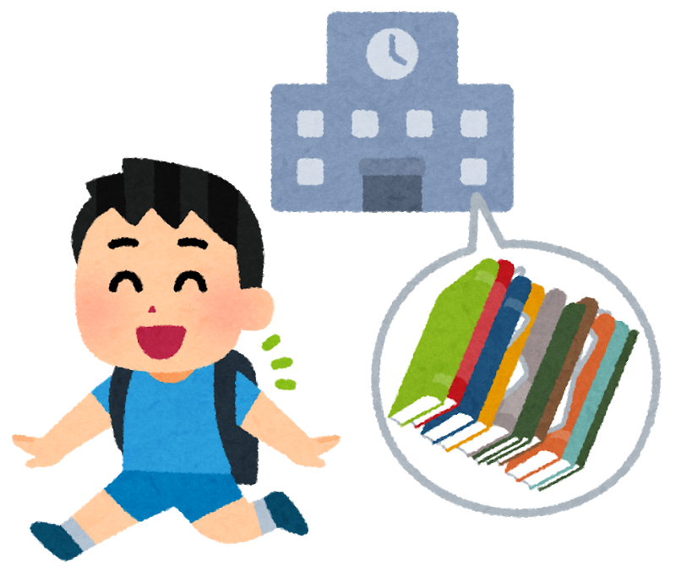
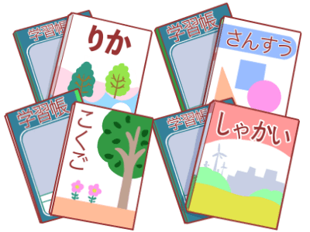
I think [ ].
A we can leave our textbook at school
B we should take our textbooks back home

