Slide 1
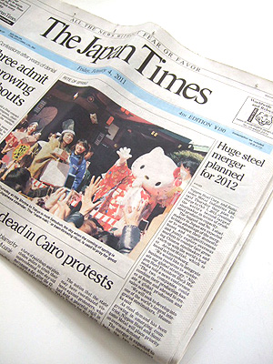
Reading books
Reading newspapers
Reading comic books
is important.

Slide 2
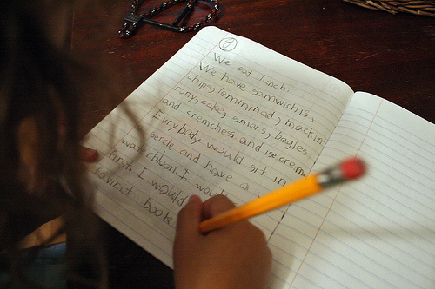
Speaking English
Writing English
Listening to English
Reading English
fun.
interesting.
difficult.
easy.
is

Slide 3
Which is fun for you?
watching sports
playing sports

Slide 4
Playing sports
is fun!
× ing
It is fun for me to play sports.
play sports.
It is 形容詞 for me to play sports.
動詞の原形.

Slide 5
It is 形容詞 for me to play sports.
play sports.
difficult
easy
exciting
fun
important

