Slide 1
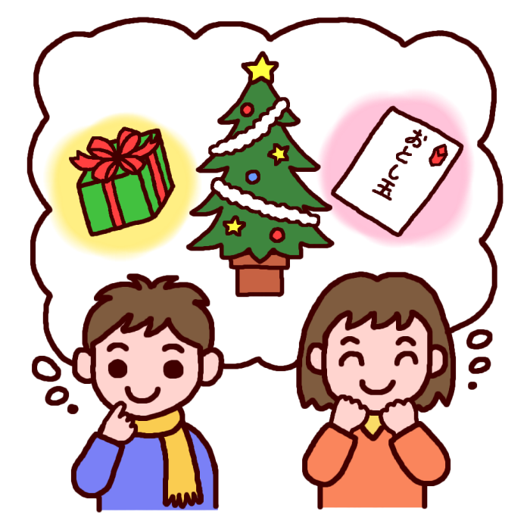
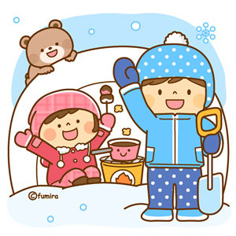
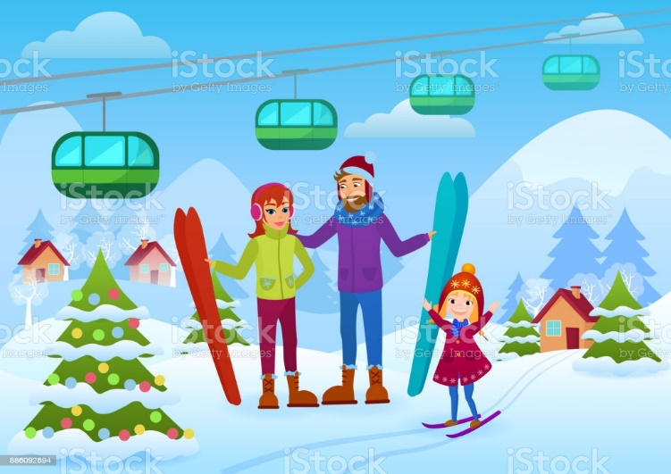
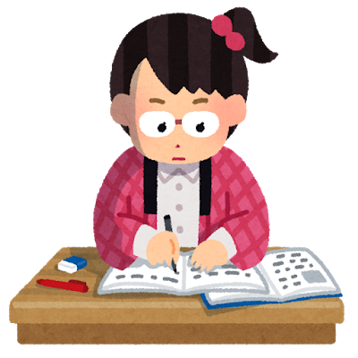
winter vacation

Slide 2
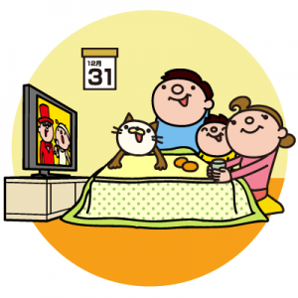
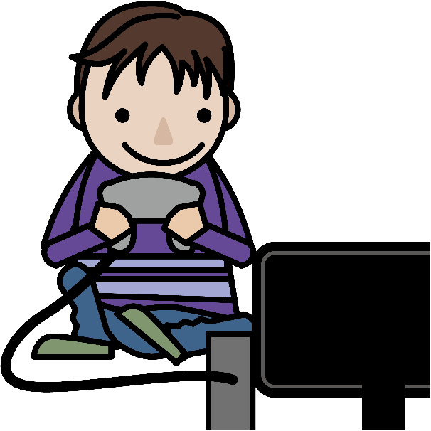
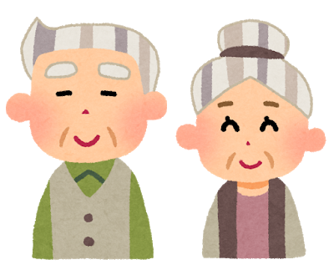
What did you do during winter vacation？
I ...
watched TV
visited my
grandparents
played games

Slide 3
過去の出来事を伝えるには・・・
動詞にedをつける！

Slide 4
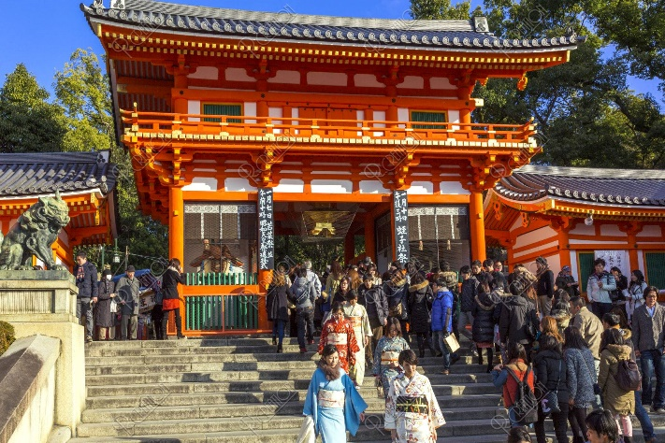
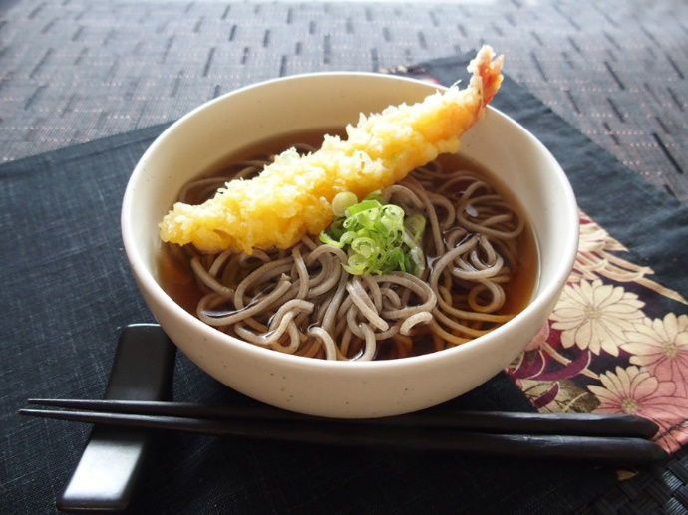
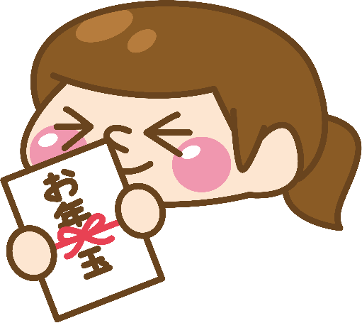
What did you do during winter vacation？
I ...
eat soba
ate
get money
got
go to a shrine
went

Slide 5
過去の出来事を伝えるには・・・
ふつうは
動詞にedをつける！
けど！
まったく違う形になる動詞もある！

