Slide 1
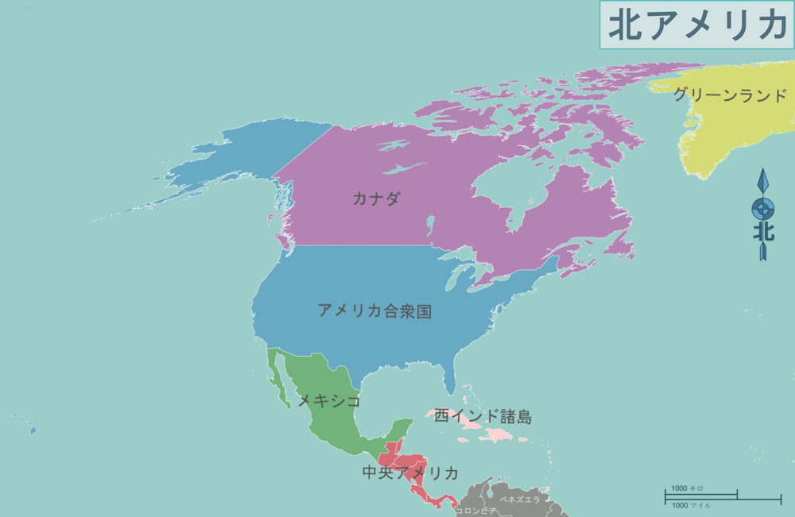
Where is Alaska？

Slide 2
I know
Where is Alaska？
where Alaska is.

Slide 3
When is his birthday?

Slide 4
when his birthday is?
When is his birthday?
Do you know

Slide 5
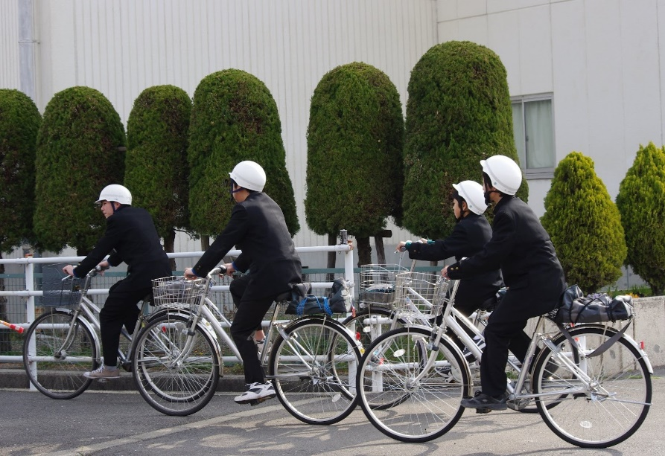
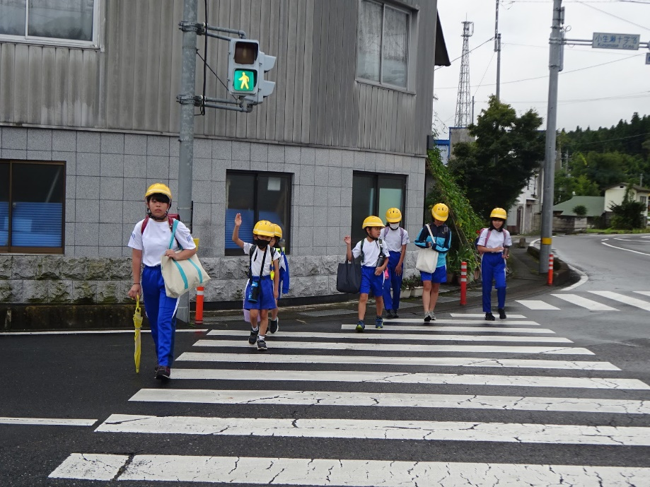
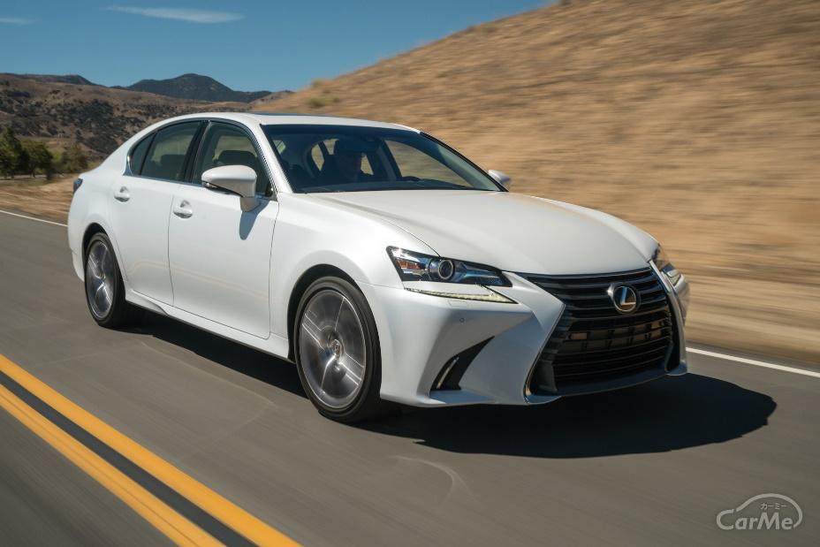
How do you come to school?

Slide 6
how you come to school.
How do you come to school?
Please tell me

