Slide 1
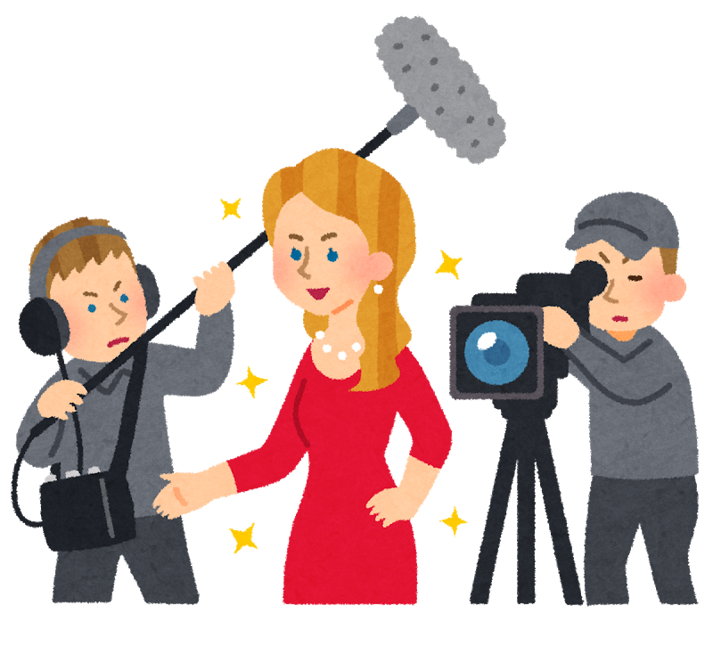
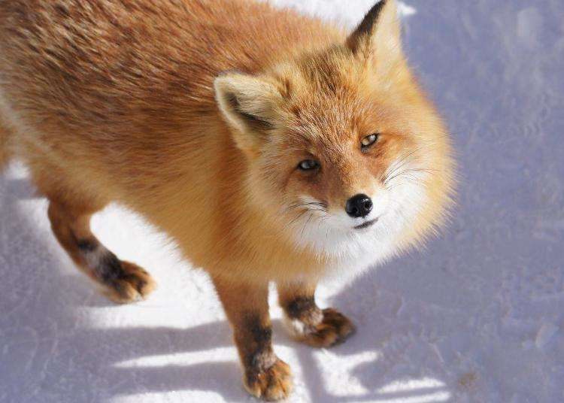
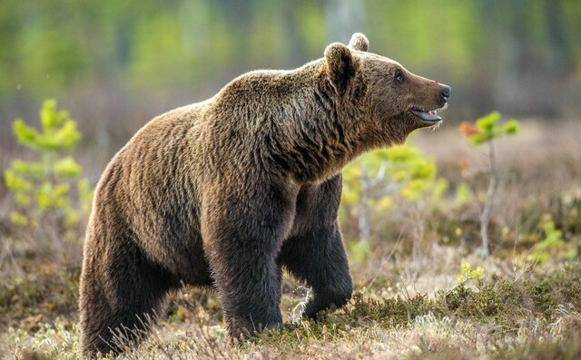
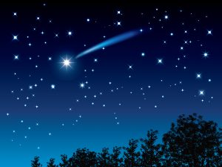
I have seen ○○ before.
I have never seen ○○ before.
Have you ever seen ○○ before?
Yes, I have. / No, I haven’t.
a movie star
a fox
a ghost
a wild bear
a shooting star

Slide 2
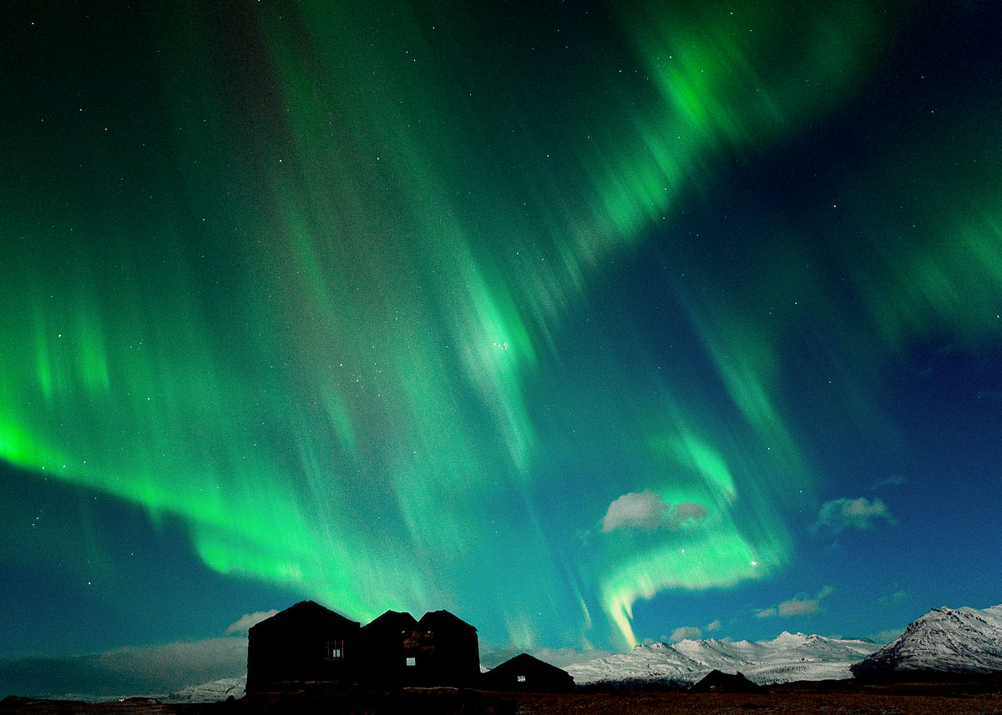
Have you ever seen an aurora?

