Slide 1
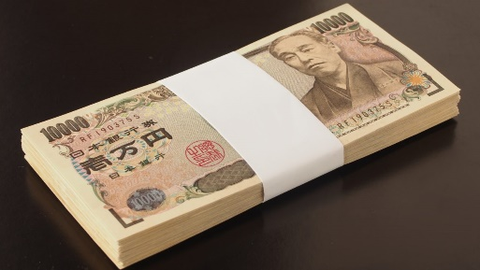
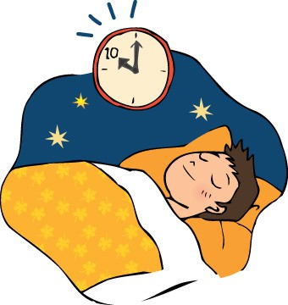
I wish ...（・・・できたらな～）
I could fly.
I had 1 million yen.
I could get 100 at the test.
I had more time to sleep.

Slide 2
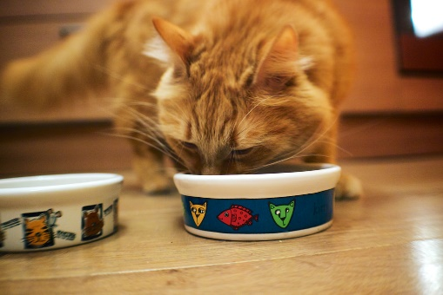
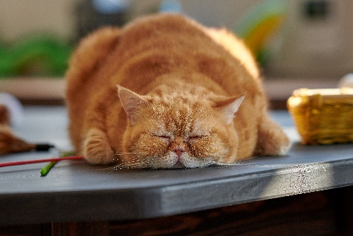
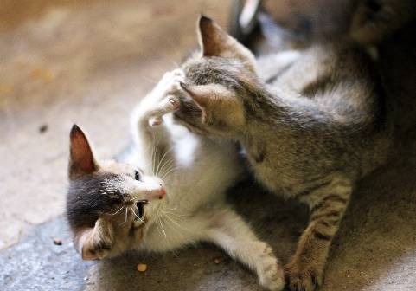
If you were a cat, what would you do?
If I were a cat, I would...
A sleep all day
B try to eat cat food
C play with other cats

