Slide 1
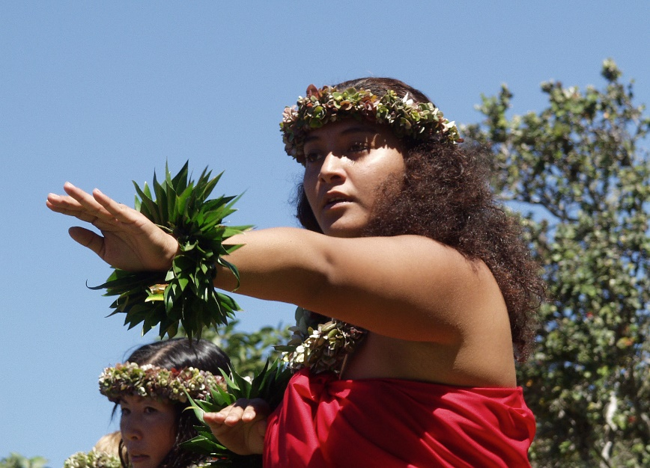
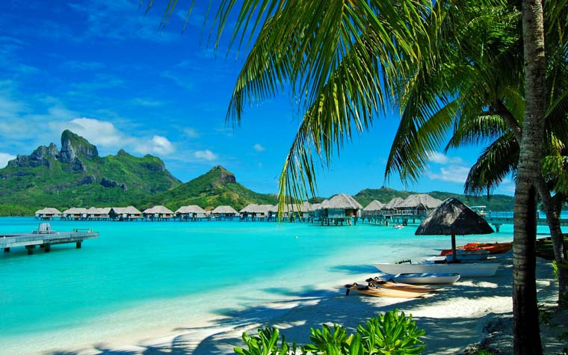
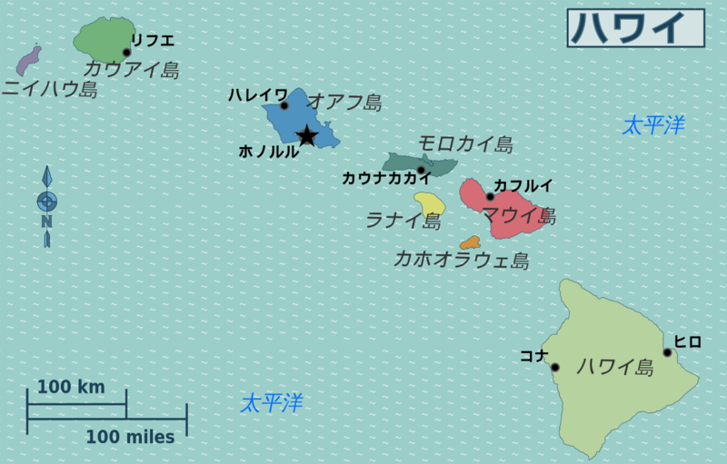
ハワイ出身の
誰かの写真

Slide 2
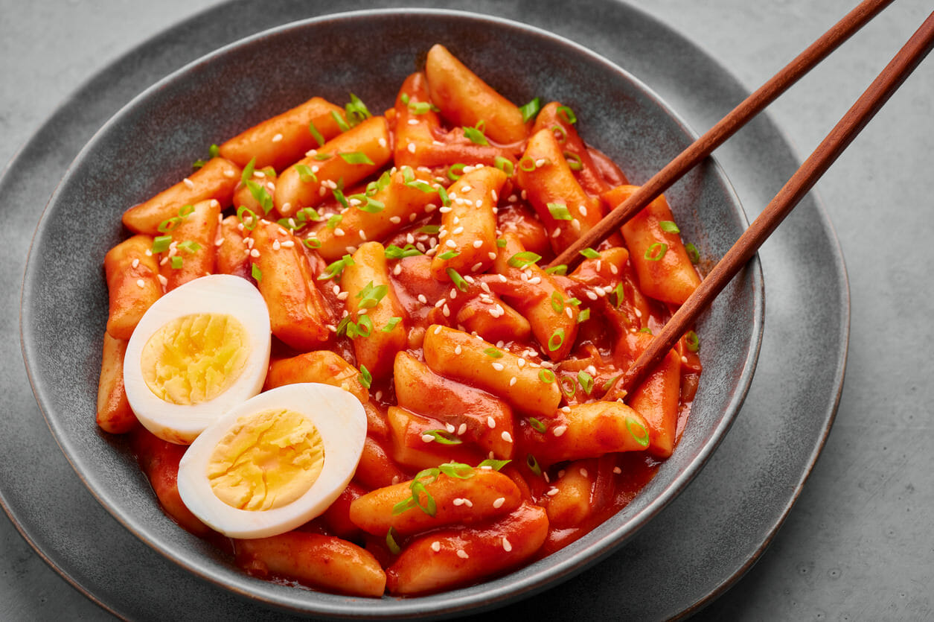
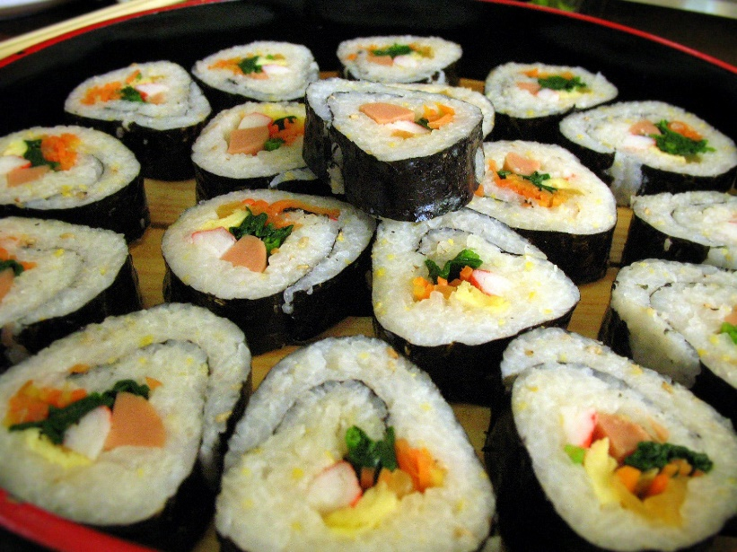
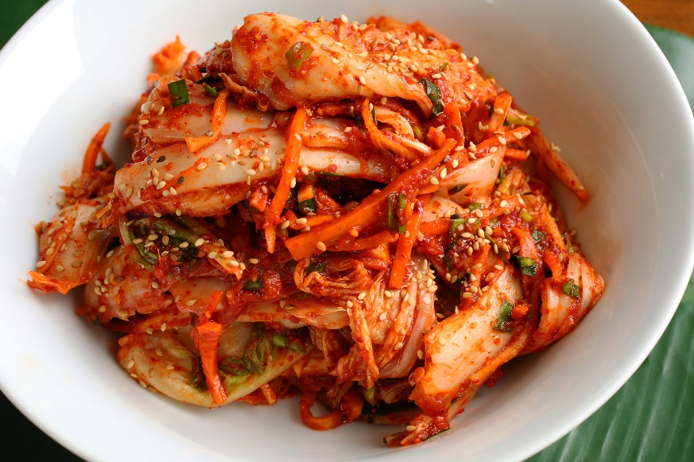
韓国料理が好きな
誰かの写真

Slide 3
English
and Japanese
英語と日本語を話す
誰かの写真

Slide 4
Josh likes dancing.

Slide 5
Meg watches cricket.

Slide 6
Meg plays badminton.

Slide 7
Asami plays badminton.

Slide 8
Ms. Cook come to school by bike.
comes

Slide 9
Kaito have miso soup for breakfast.
has

Slide 10
Ms. Cook have toast for breakfast.
has

Slide 11
Kaito want to be a soccer player.
wants

Slide 14
Asami and Meg play badminton.

Slide 15
?
He does not like a mouse.

Slide 16
?
He does not like water.

