Slide 1
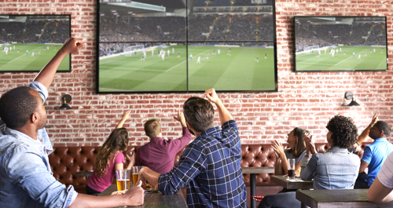
Which is fun for you?
To watch sports
To play sports

Slide 2
To play sports
is fun!
to play sports.
=It is fun for me
It is 形容詞 for me
to + 動詞の原形.

Slide 3
It is 形容詞 for me play sports.
to play sports.
difficult
easy
exciting
fun
important

