Slide 1
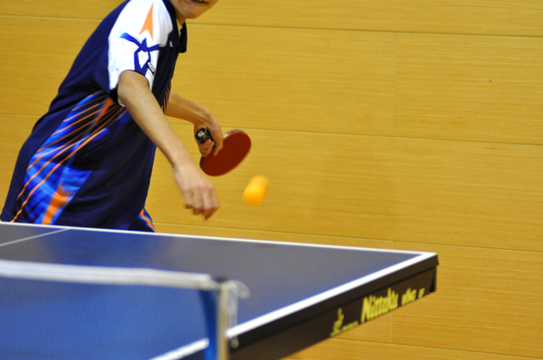
What makes you happy?
Listening to music
Playing sports
Reading books

Slide 2
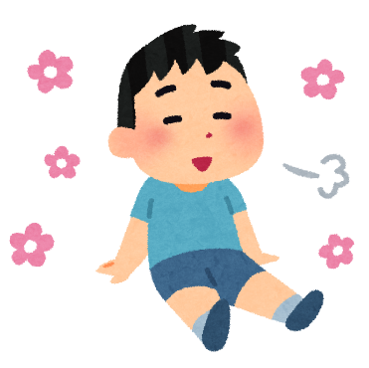
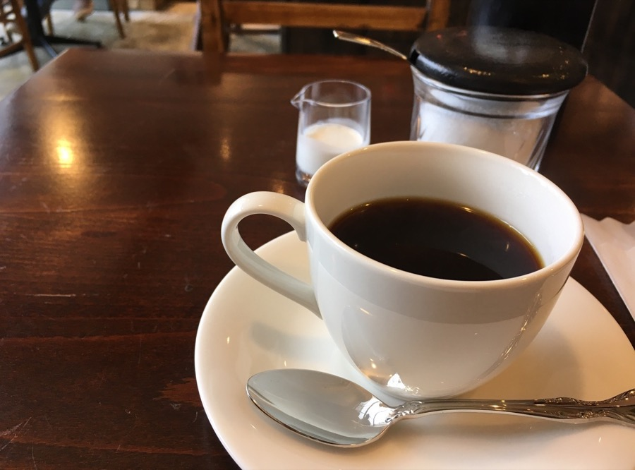
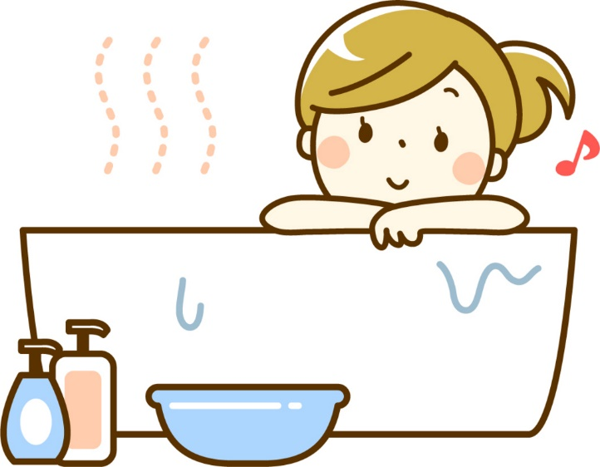
What makes you relaxed?
A lot of sleep
Taking a bath
Drinking coffee

