Slide 1
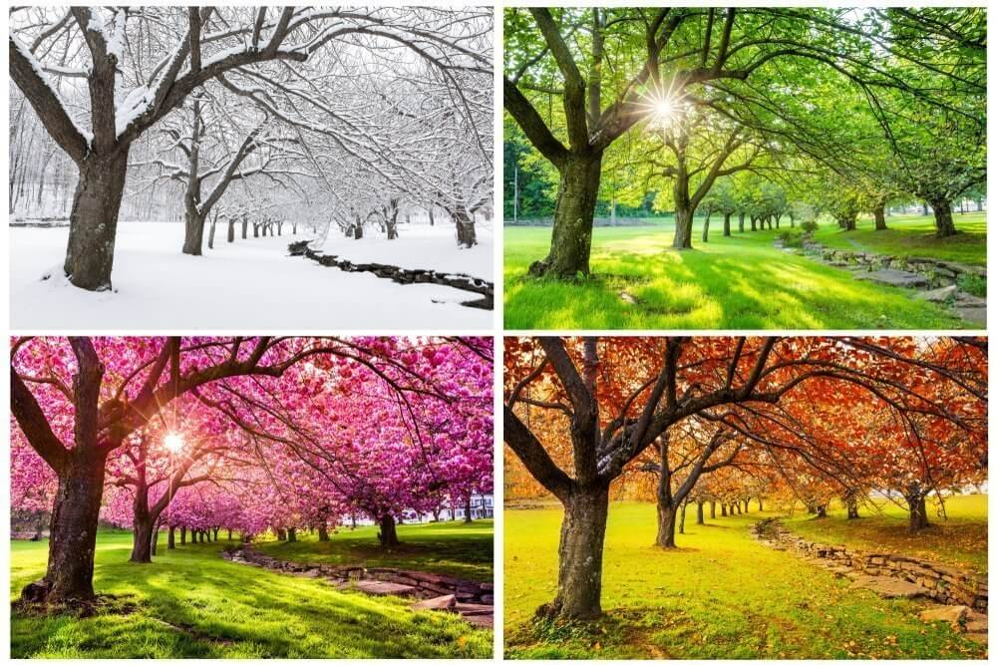
Which season do you like?

Slide 2
Why?
Because we can swim in the sea.
Because it’s not too hot or too cold.
Because we have a long vacation.
Because we can play with snow.
….

Slide 3
I like summer because we have a long vacation.
I like winter because we can play with snow.
わたしは夏が好き なぜなら 長い休みがあるからです。
わたしは冬が好き なぜなら 雪で遊べるからです。
接続詞 because
「なぜなら・・・」
S V because S V .
結論 because 理由

