Slide 1
Can you guess what I am?

Slide 2
I am an animal that lives in Africa.
I am very, very tall.
I am brown with yellow spots.
What am I?

Slide 3
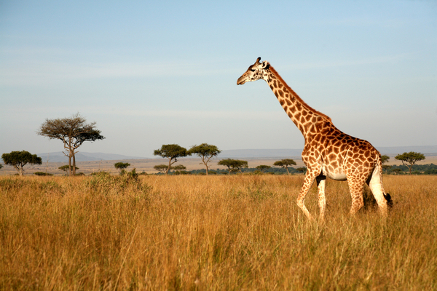
I’m a giraffe!

Slide 4
I am a boy.
My best friends are dog, monkey, and bird.
I want to fight oni.
Who am I?

Slide 5
That’s right! I’m Momotaro.

Slide 6
I am a food.
I have meat, potatoes, carrots, rice, and sauce.
I’m based on a food from India.
What am I?

Slide 7
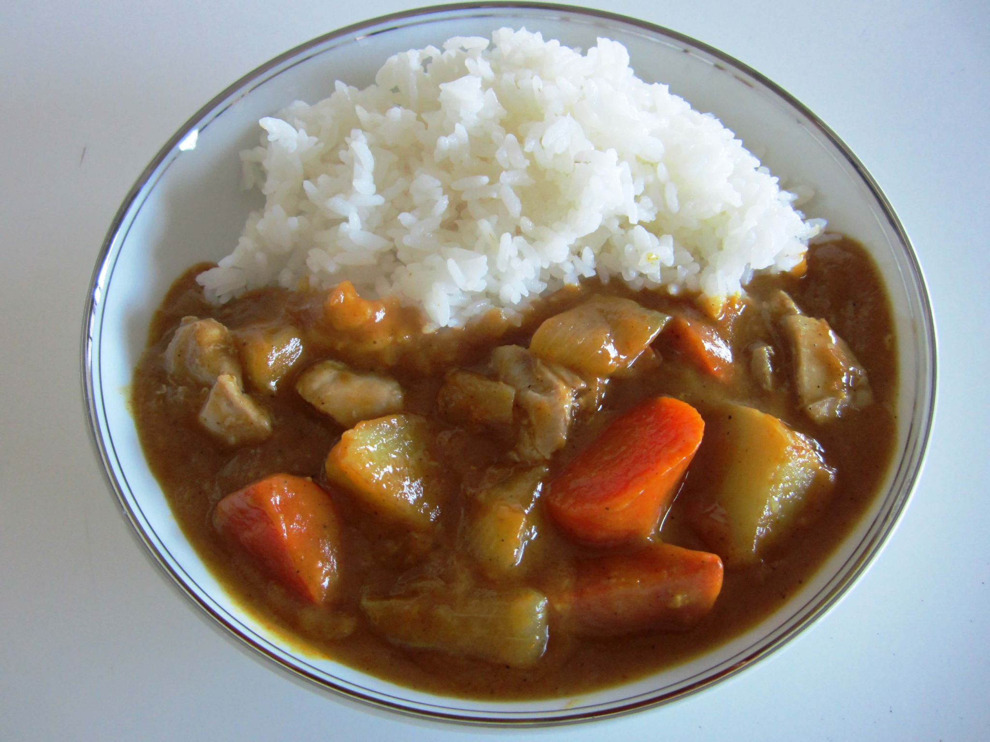
Yes, I’m curry and rice!

