Slide 1
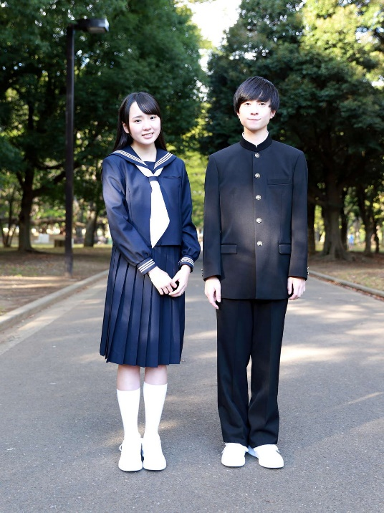
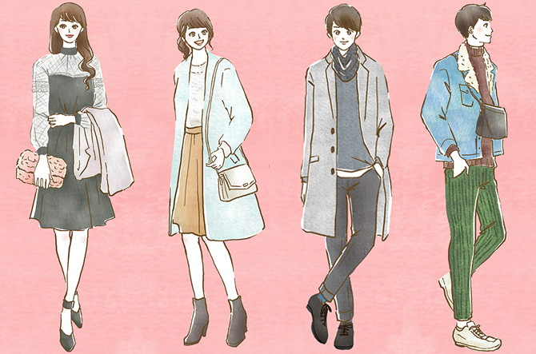
What do you think?
We should wear a school uniform.
We should wear casual clothes.

Slide 2
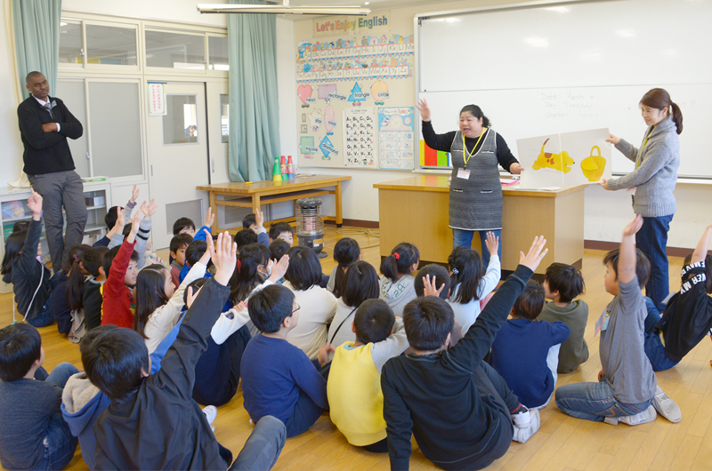
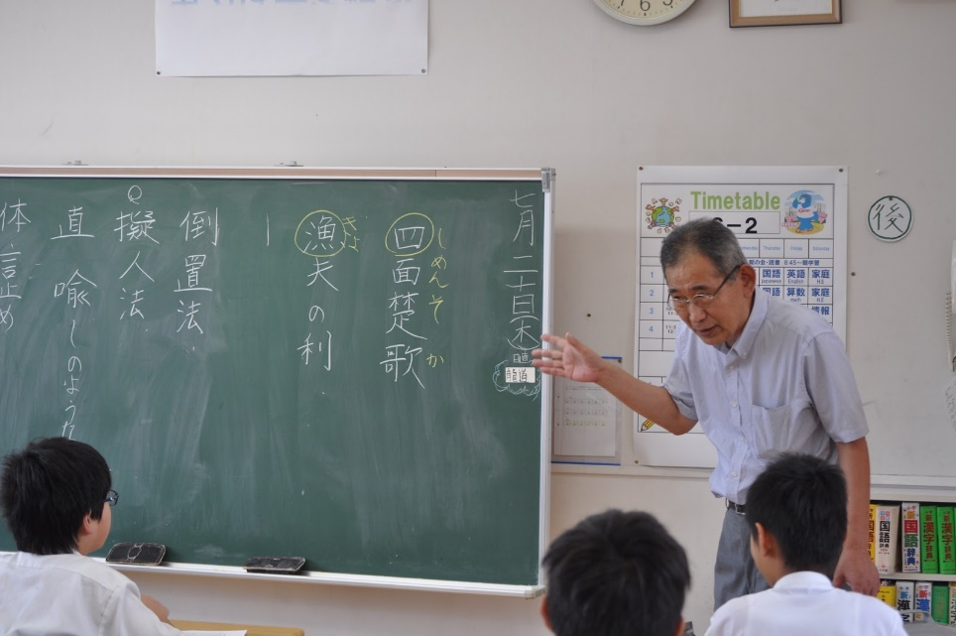
What do you think?
Elementary school students should study English.
They should study Japanese more.

Slide 3
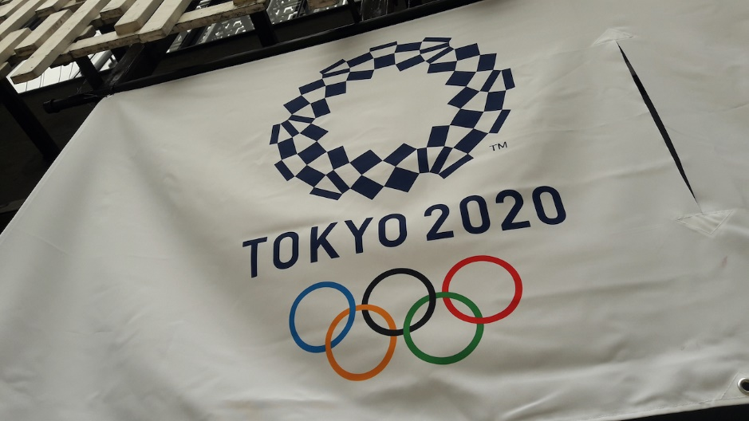
What do you think?
We should hold the Olympic games.
We should cancel the Olympic games.

Slide 4
What do you think?
あなたはどう思う？
I think (that) we…
わたしは、・・・だと思います。

