Slide 1
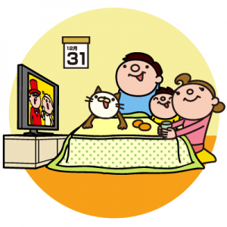
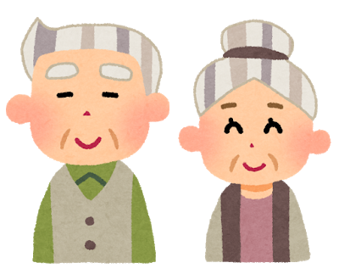
What did you do during winter vacation？
I ...
watched TV
visited my
grandparents
played games

Slide 2
How was it?
It was...
exciting
boring
fun

Slide 3
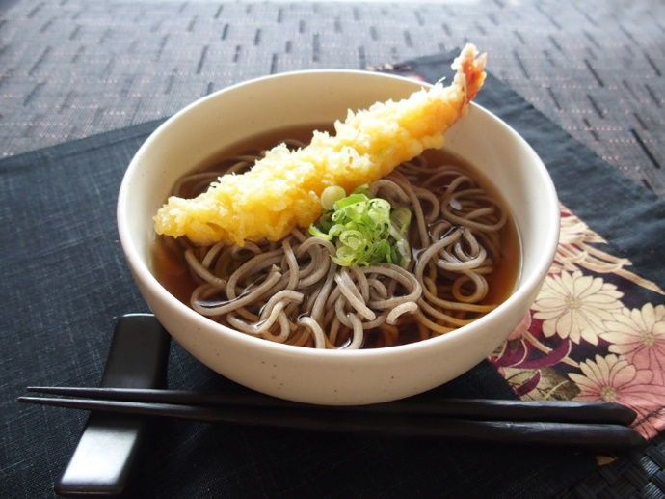
Did you eat soba?
Yes, I did.
No, I didn’t.

Slide 4
How was it?
It was...
good
not so good
delicious

Slide 5
It is delicious.
（それはおいしい。）
It was delicious.
（それはおいしかった。）
be動詞にも過去形がある！

Slide 6
I am eating sushi now.
I was eating sushi then.

Slide 7
Kaito is reading a book now.
Kaito was reading a book then.

Slide 8
Asami is talking with her friends.
Asami was talking with her friends.

Slide 9
Meg and I are playing games.
Meg and I were playing games.

