Slide 1
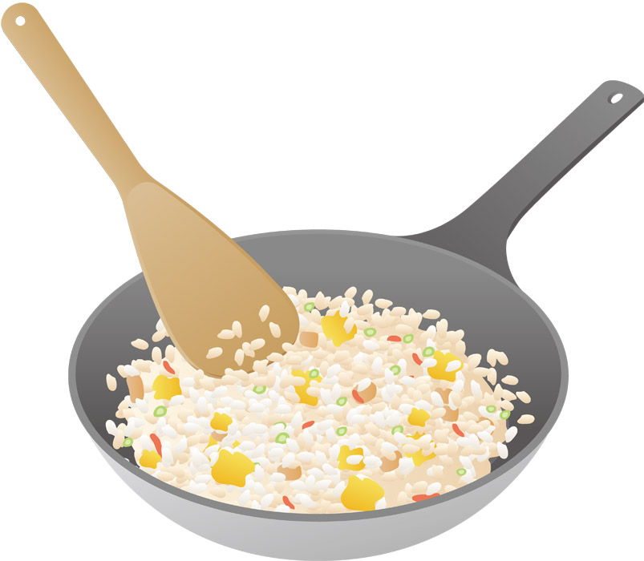
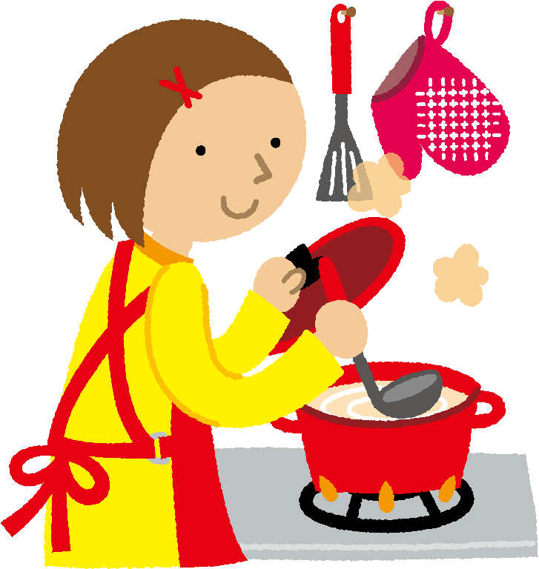
Do you like cooking?

Slide 2
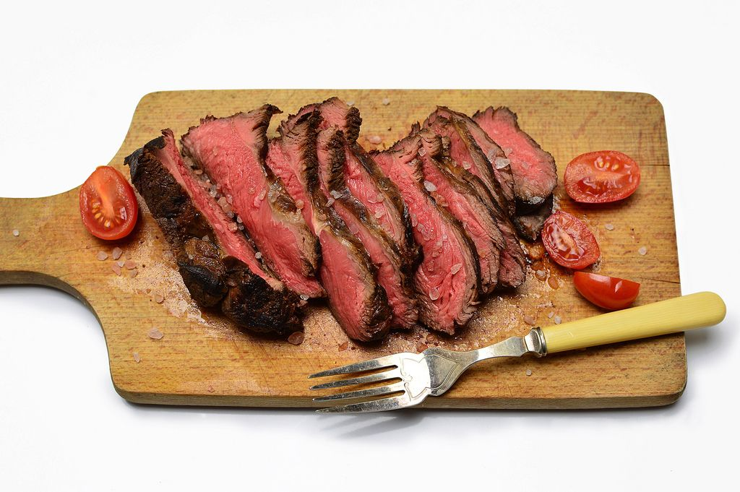
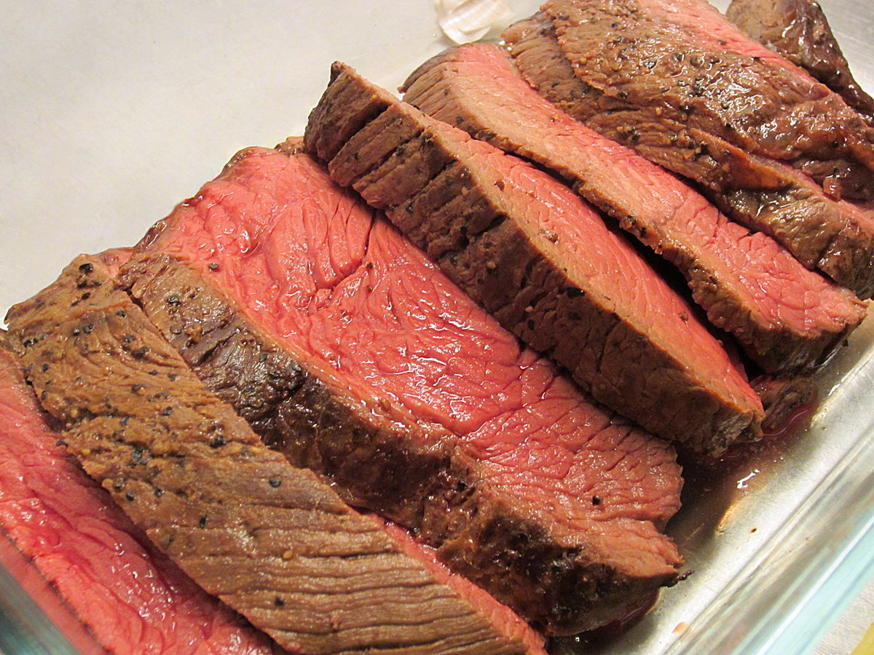
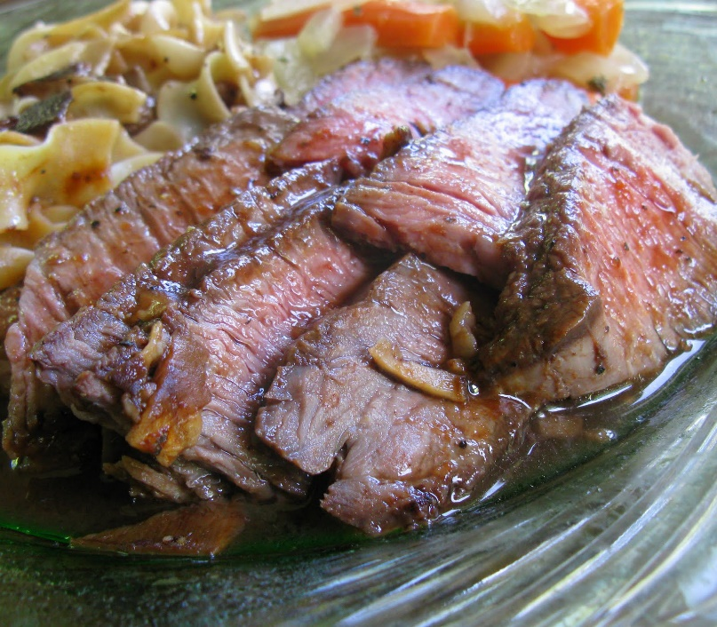
Do you know how to cook roast beef easily?

Slide 3
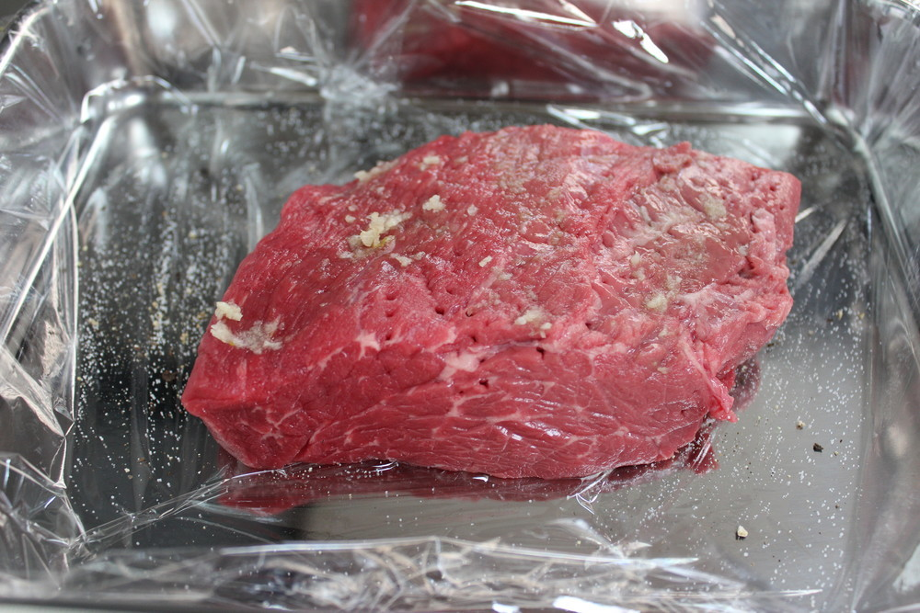
1. Put salt, pepper and garlic on the beef.

Slide 4
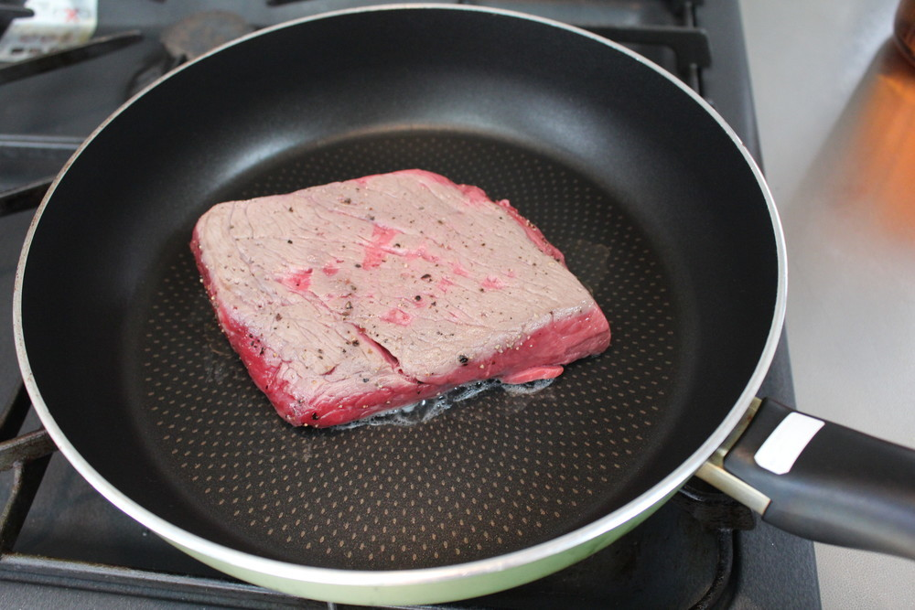
2. Grill the beef until it gets brown

Slide 5
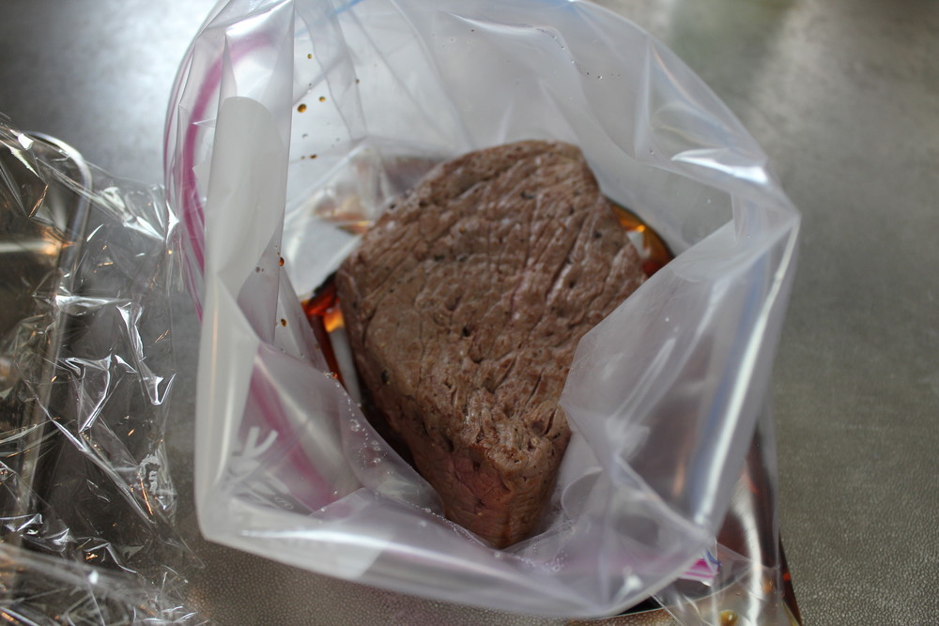
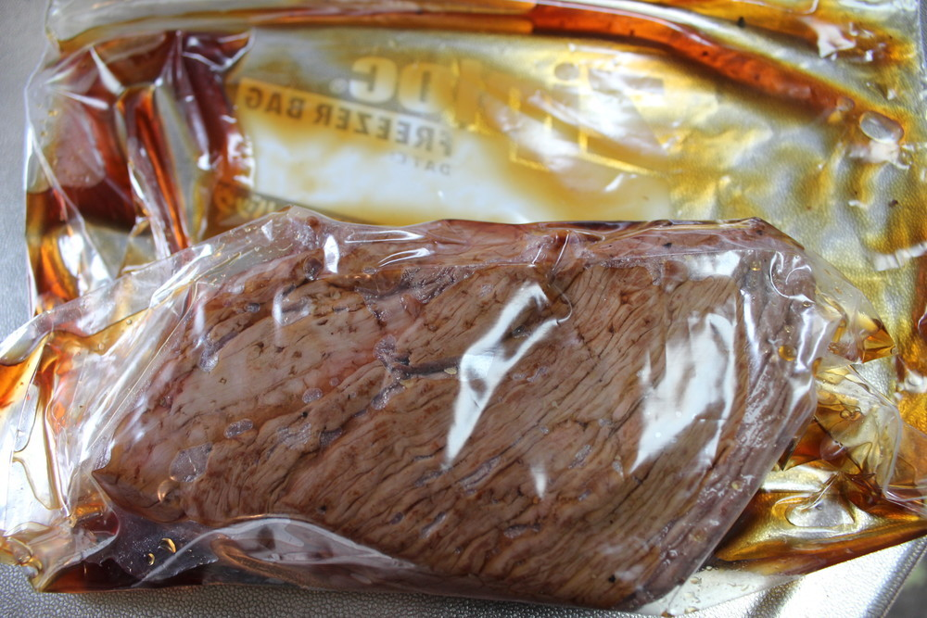
3. Put the beef inside a ziplock bag, let all the air out, and close it well

Slide 6
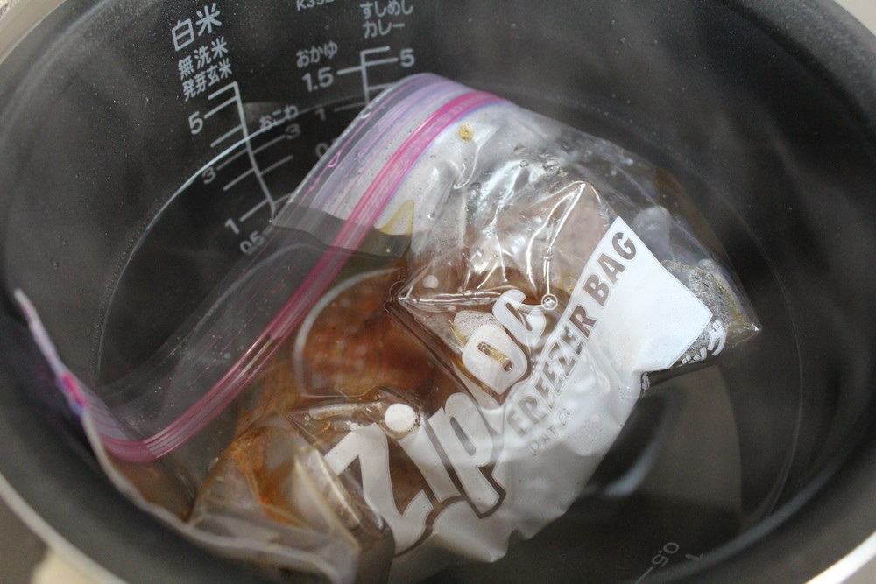
4. Put boiled water in the rice cooker and then ziplock bag.

Slide 7
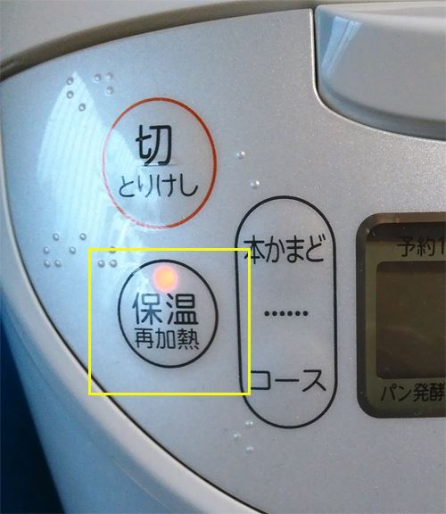
5. Press KEEP WARM button Wait for 1 hour

Slide 8
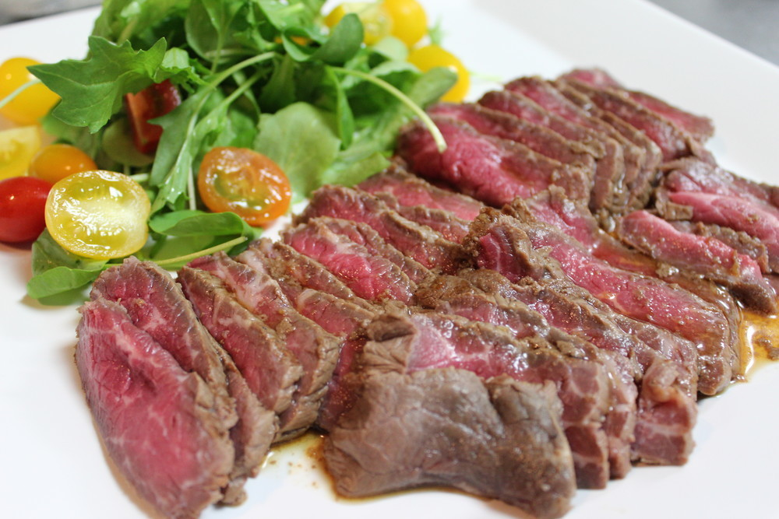
Finish!

