Slide 1
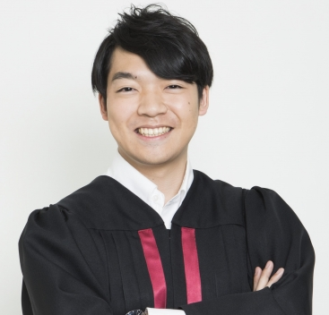
Izawa Takushi
quiz player

Slide 2
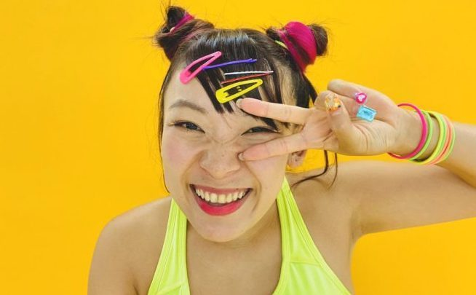
Fuwa-chan
comedian

Slide 3
A Look at this picture.
Do you know him(her)?
YES!
NO!
B Yes, I do. He is ○○.
He is a （職業）.
He...（その他の情報）
A Do you like him?
B Yes, I do. / No, I don’t.
B No, I don’t.
Who is he?
A He is 〇〇.
He is a （職業）.
He... （その他の情報）
B Oh, I see.

Slide 4
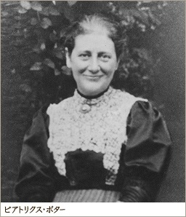

Slide 5
