Slide 2
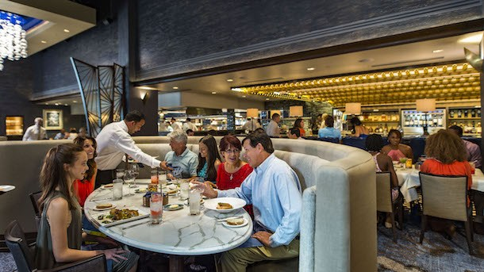
Restaurants
店員さん
We ( ) give the sever a tip.

Slide 3
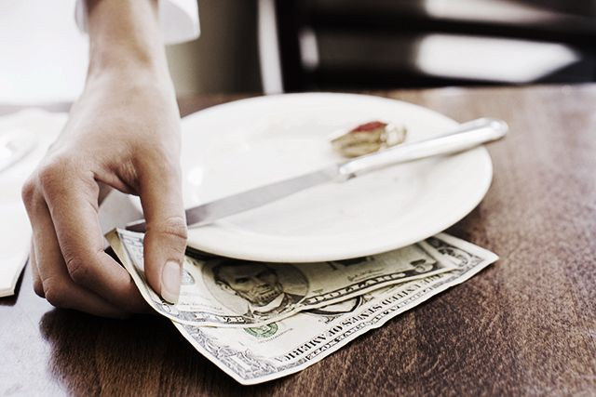
Restaurants
店員さん
We ( must ) give the server a tip.

Slide 4
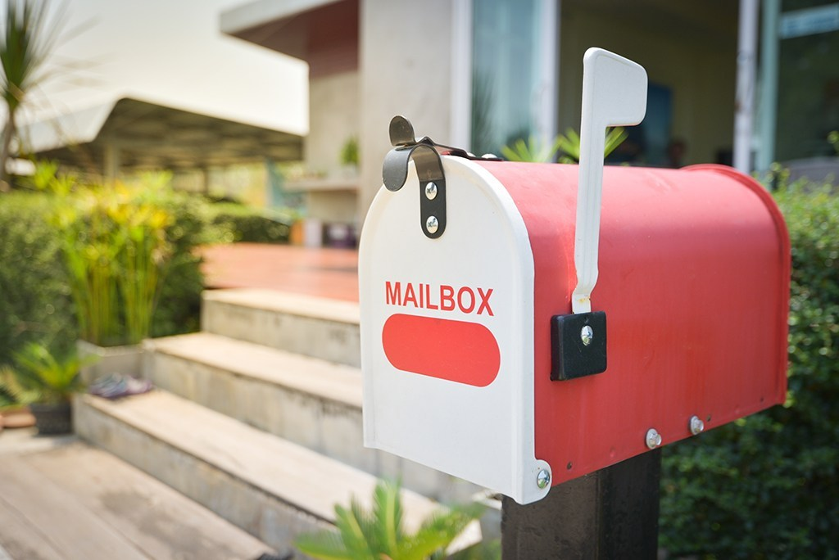
At Home
We ( )( )( )to send letters from the post office.

Slide 5
At Home
We (don’t)(have)(to) to send letters from the post office.

Slide 6
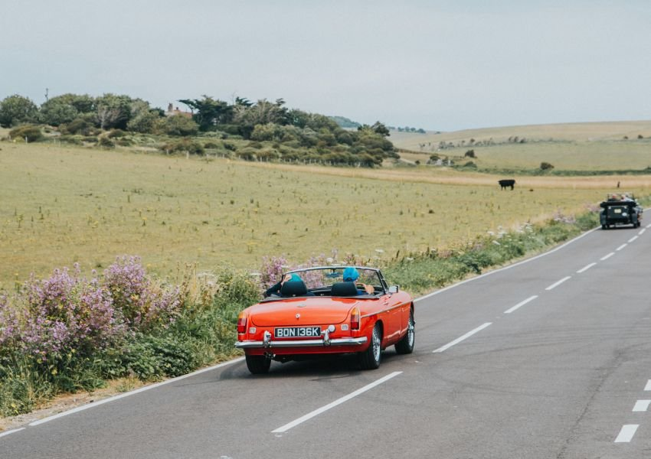
Transportation
We ( )( ) drive on the left side.

Slide 7
Transportation
We (must)(not) drive on the left side.

Slide 8
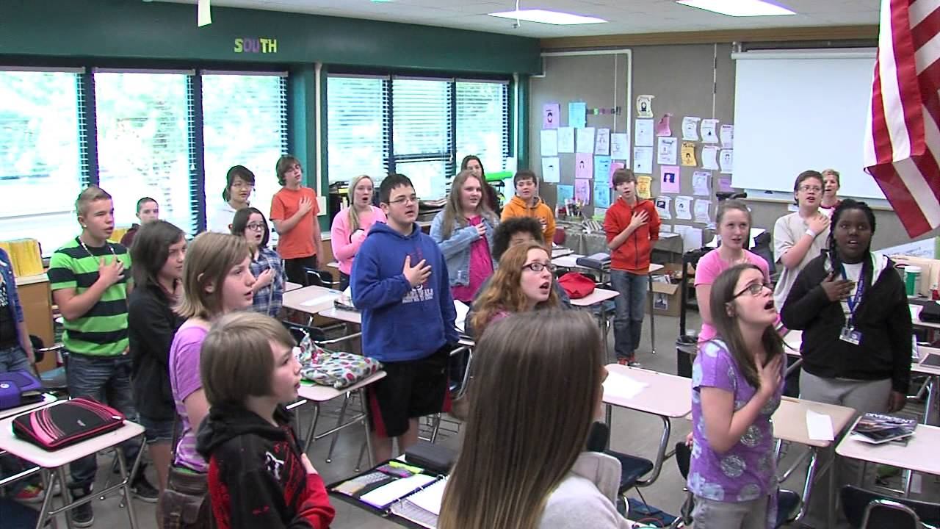
At School
忠誠の誓い
Students( )( ) say the pledge of allegiance.

Slide 9
At School
忠誠の誓い
Students(have)(to) say the pledge of allegiance.

Slide 10
In an Emergency
緊急時
You ( ) call 911 in an emergency.

Slide 11
In an Emergency
緊急時
You (must) call 911 in an emergency.

Slide 12
How about in Japan? What is a special rule in Japan?

